Slide 1


ToR 5: Mackerel
Kiersten Curti & Alex Hansell
Working paper 10
2/XX/24

Slide 2
Timeline
Last benchmark 2017
Last management track 2023
Next management track 2025

Slide 3
Previous panel recommendations:

Slide 4
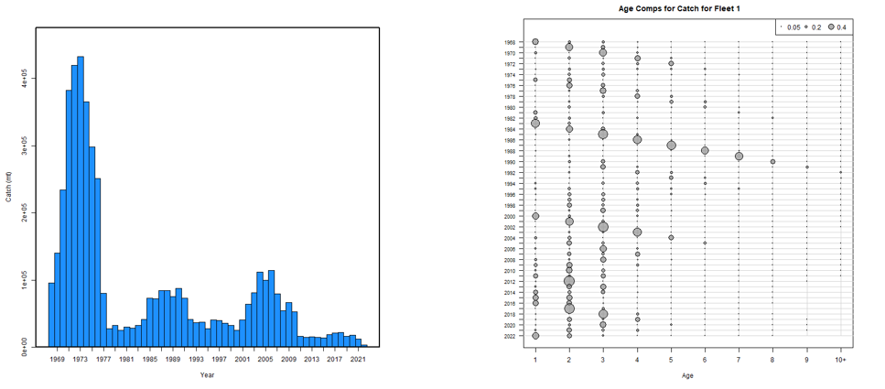
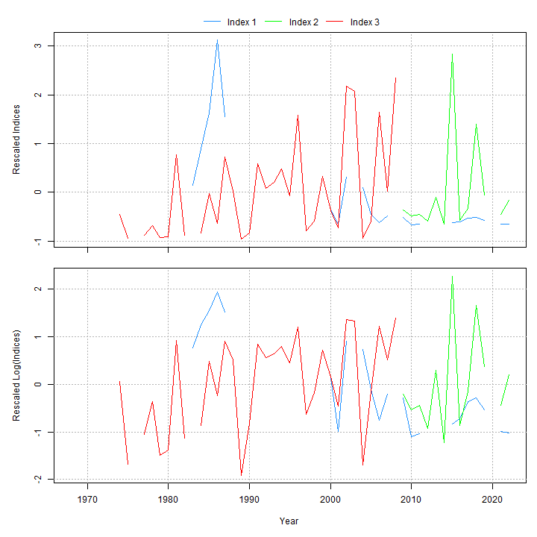
Data inputs
Age Structured Assessment Program (ASAP)
Ages 1-10+
Catch at age (1968-2022)
Surveys:
NEFSC spring (Albatross 1968-2008)
NEFSC spring (Bigelow 2009-2022)
Egg survey (1983-1987; 2000-2022)
Natural mortality = 0.2

Slide 5
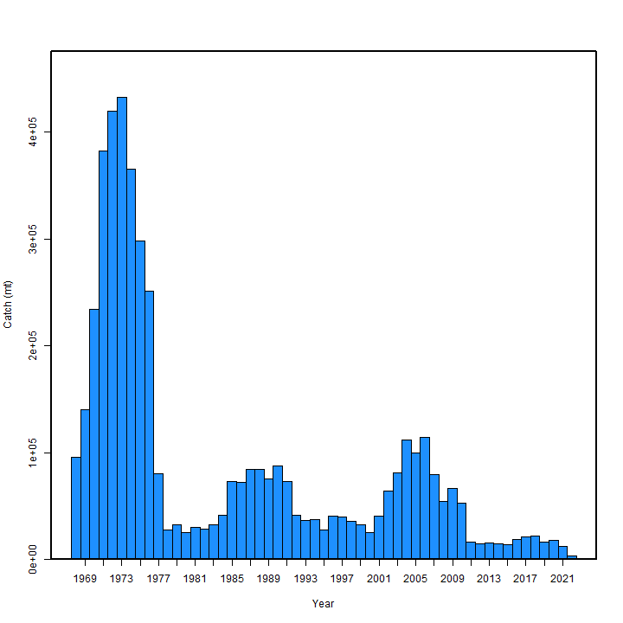
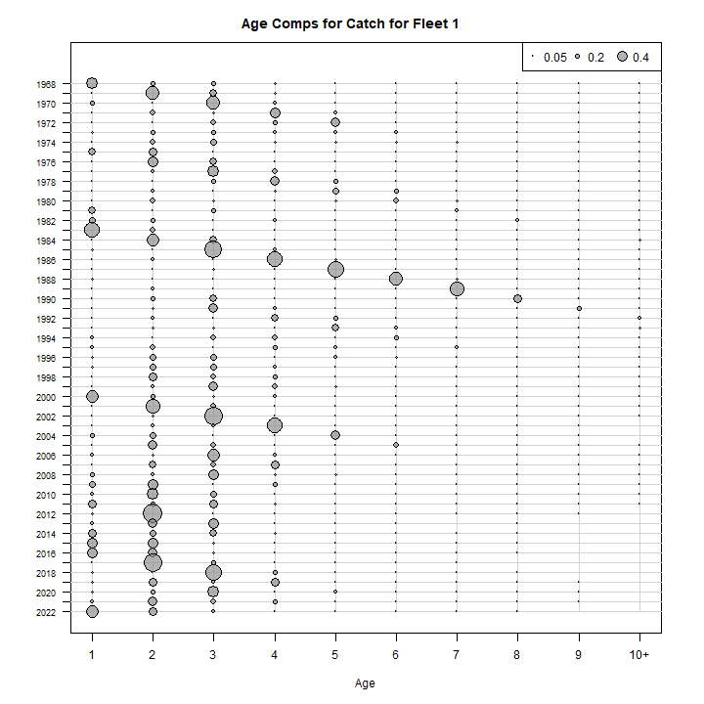
Catch at age
Figure 1 WP 10

Slide 6
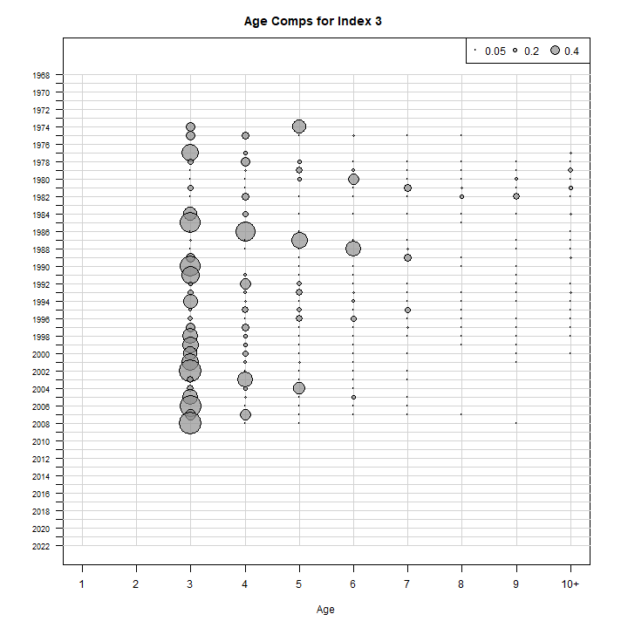
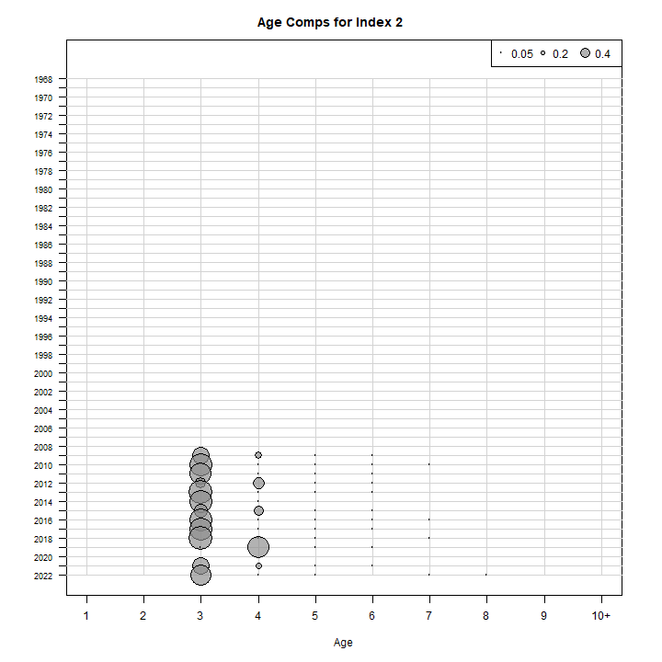
Survey indices
Index 1 = Egg index
Index 2 = Albatross
Index 3= Bigelow
Figure 2 WP 10
Figure 3 WP 10

Slide 7
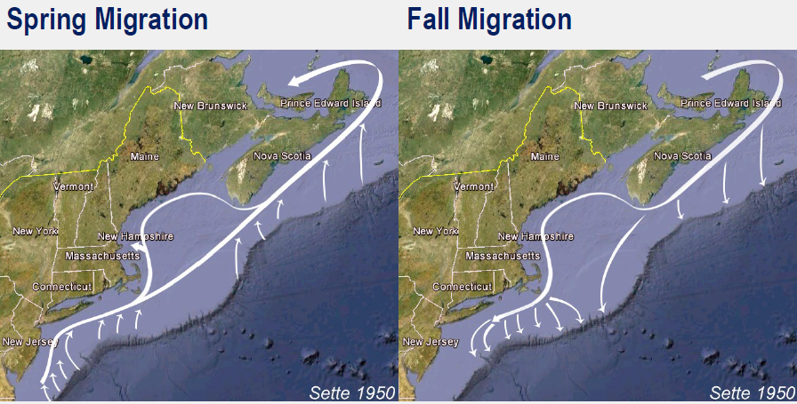

The plan
ASAP → WHAM
Age-comps
Recruitment
Time varying
Selectivity
NAA

Slide 8
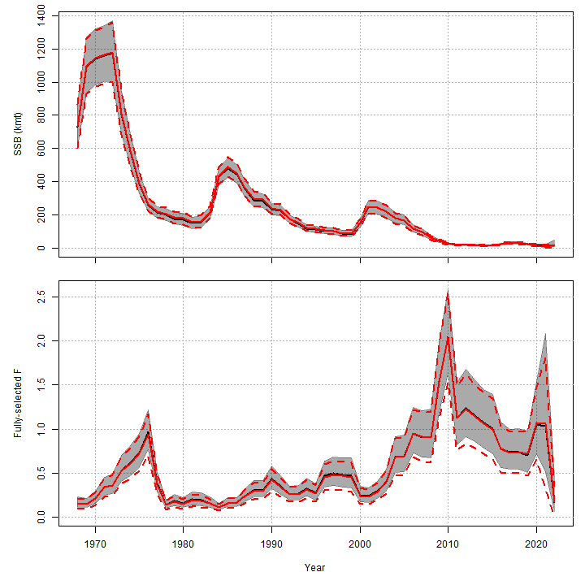
ASAP to WHAM
ASAP
WHAM
Figure 4 WP 10

Slide 9
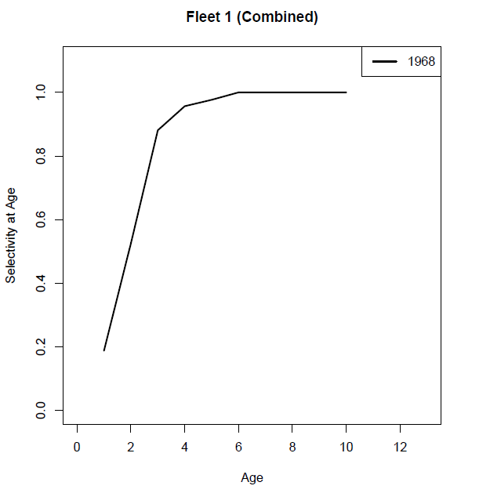
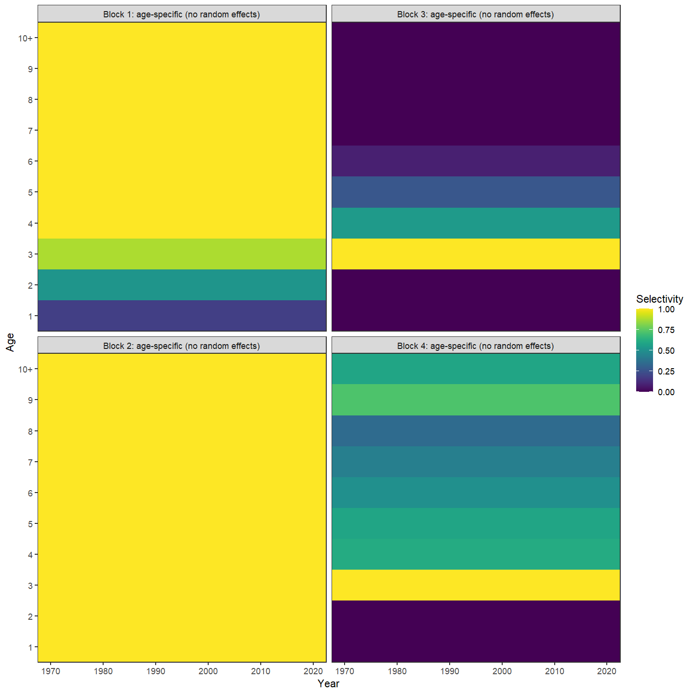
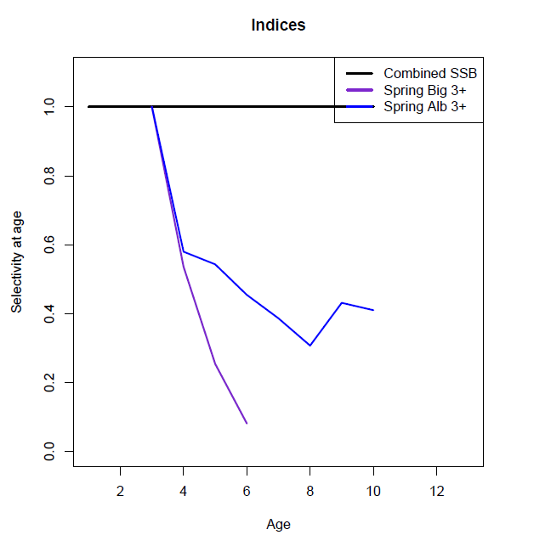
Selectivity
Block 1 = Catch
Block 2 = Egg index
Block 3 = Albatross
Block 4= Bigelow
Figure 5 WP 10
Figure 6 WP 10

Slide 10

The plan
ASAP → WHAM
Age-comps
Recruitment
Time varying
Selectivity
NAA

Slide 11
Age composition comparison
age_comp | converged | hessian | NLL | rho_R | rho_SSB | rho_Fbar
multinomial | Yes | No | 2305.805 | 0.1608 | 0.3633 | -0.228
dir-mult | Yes | Yes | 1769.636 | 0.5752 | 0.8363 | -0.4225
dirichlet-miss0 | Yes | Yes | -1488.64 | 0.9747 | 1.1804 | -0.4947
dirichlet-pool0 | Yes | Yes | -1481.17 | 0.9476 | 1.1474 | -0.4894
logistic-normal-miss0 | Yes | Yes | -1344.85 | 0.7369 | 0.7068 | -0.2969
logistic-normal-ar1-miss0 | Yes | Yes | -1578.05 | 0.8776 | 0.8802 | -0.4192
logistic-normal-pool0 | Yes | Yes | -1319.17 | 0.6501 | 0.6585 | -0.2722
mvtweedie | Yes | Yes | -1319.17 | 0.1809 | 0.5006 | -0.2307
Table 1 WP 10

Slide 12
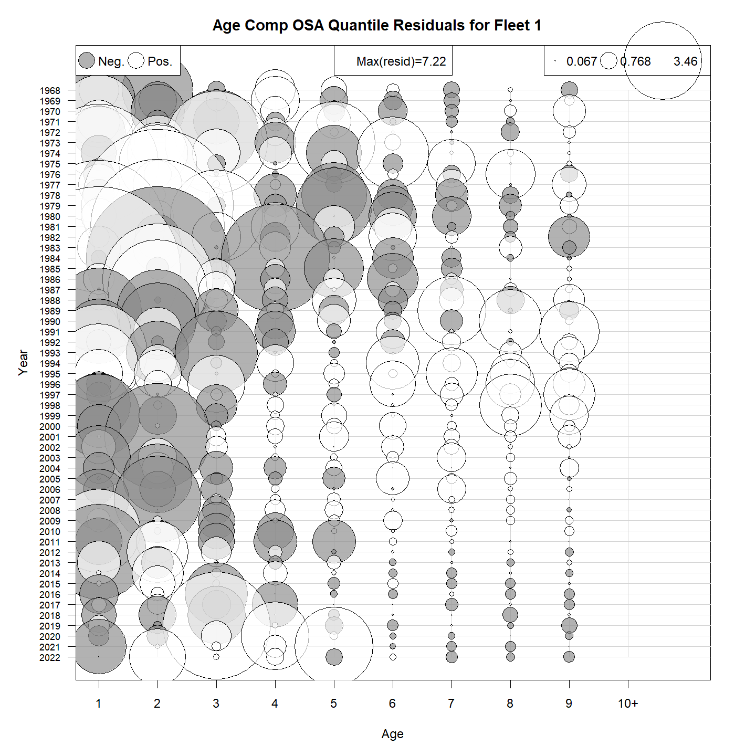
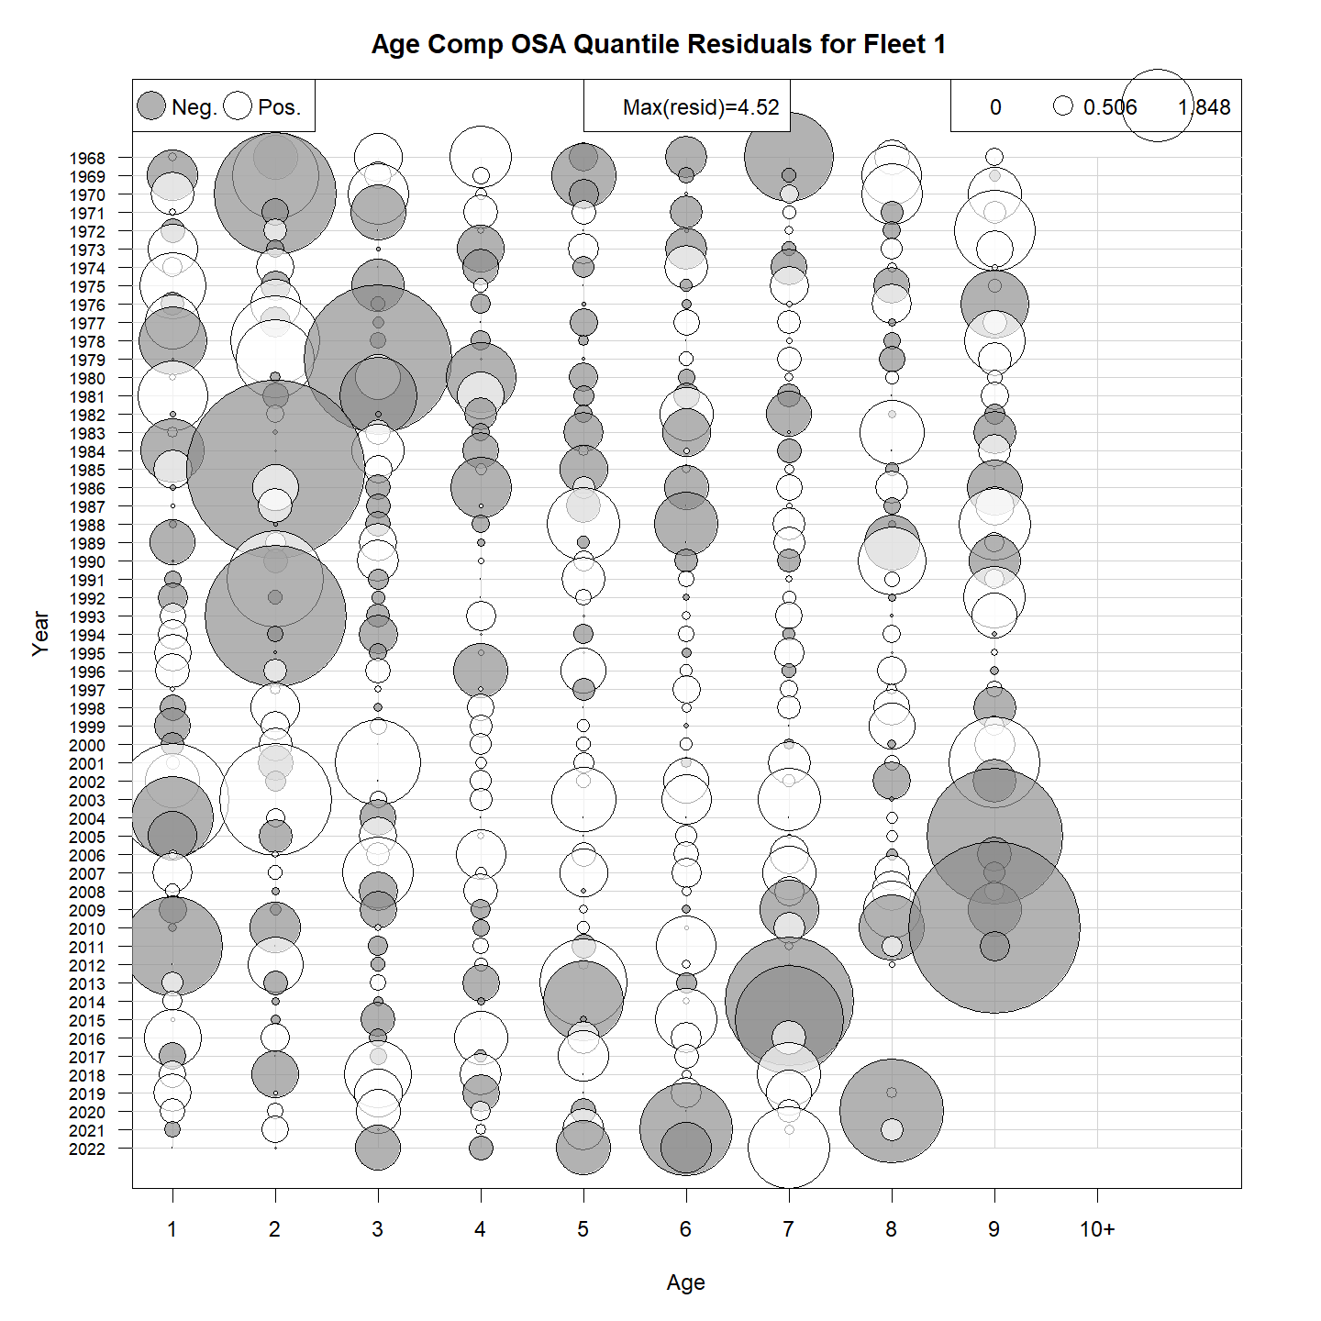
Catch OSA
Multinomial
Logistic-normal-ar1-miss0
GitHub Run1 & Run2

Slide 13
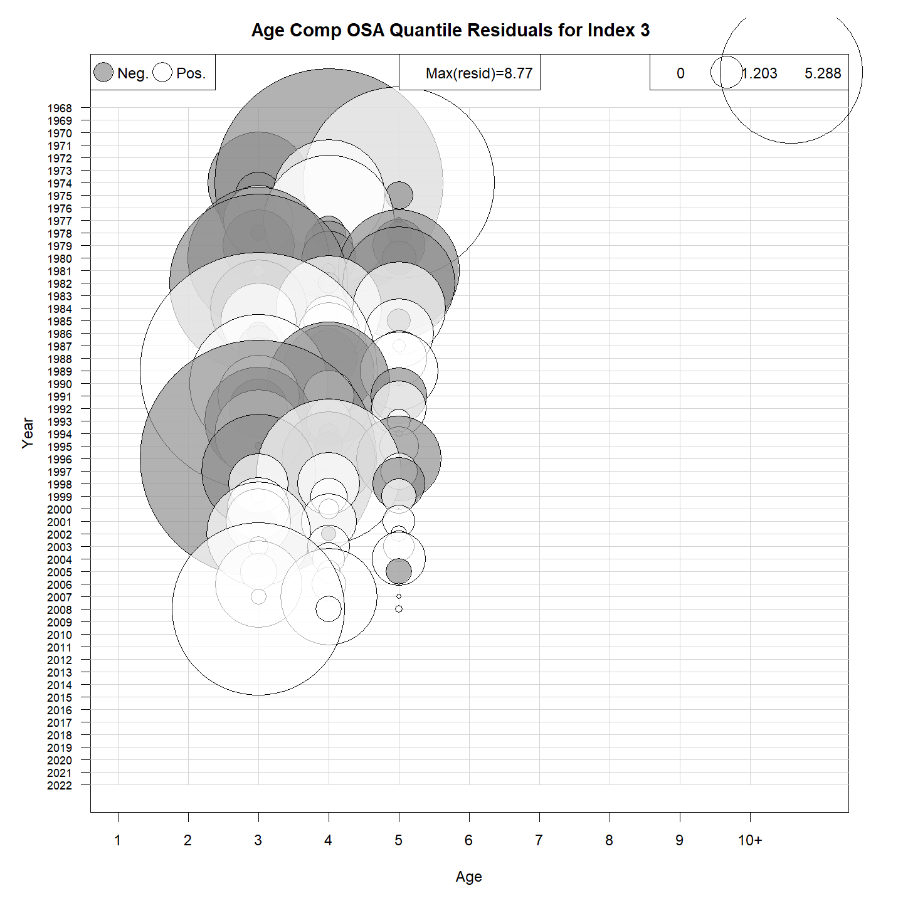
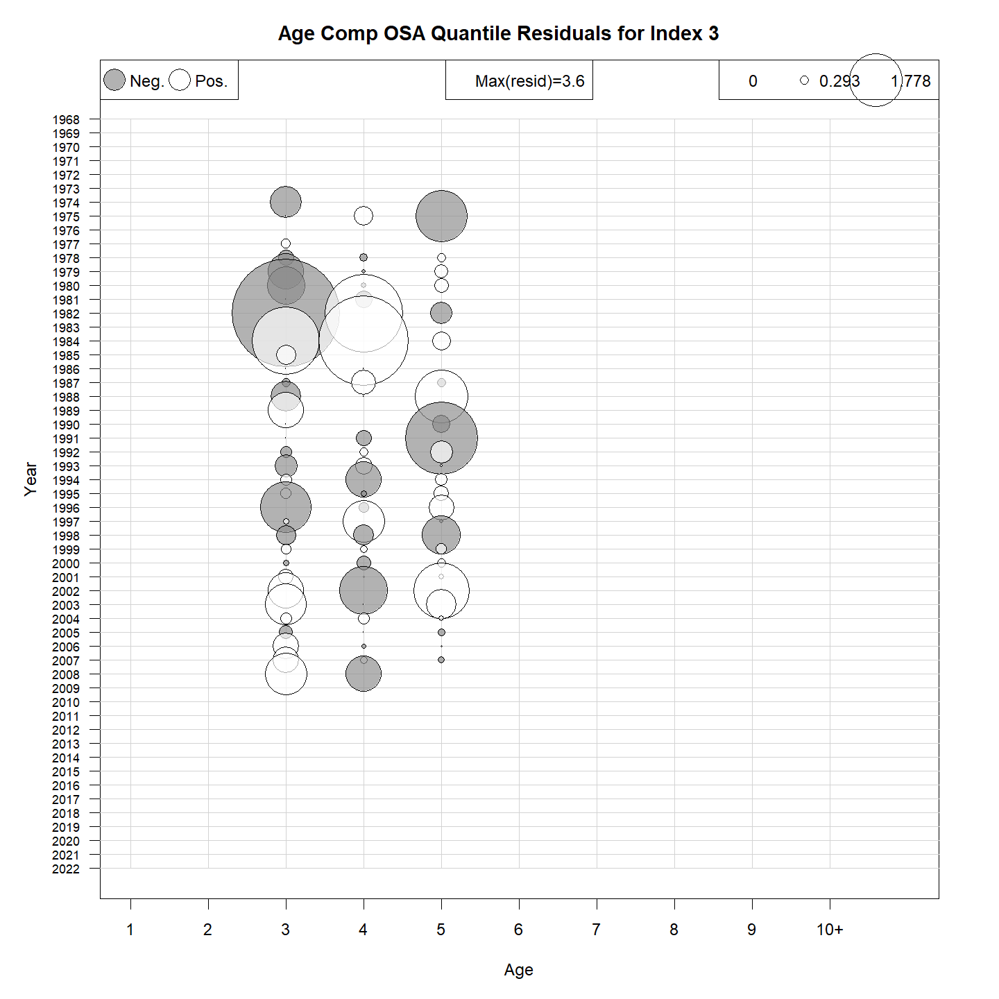
NEFSC Albatross OSA
Multinomial
Logistic-normal-ar1-miss0

Slide 14
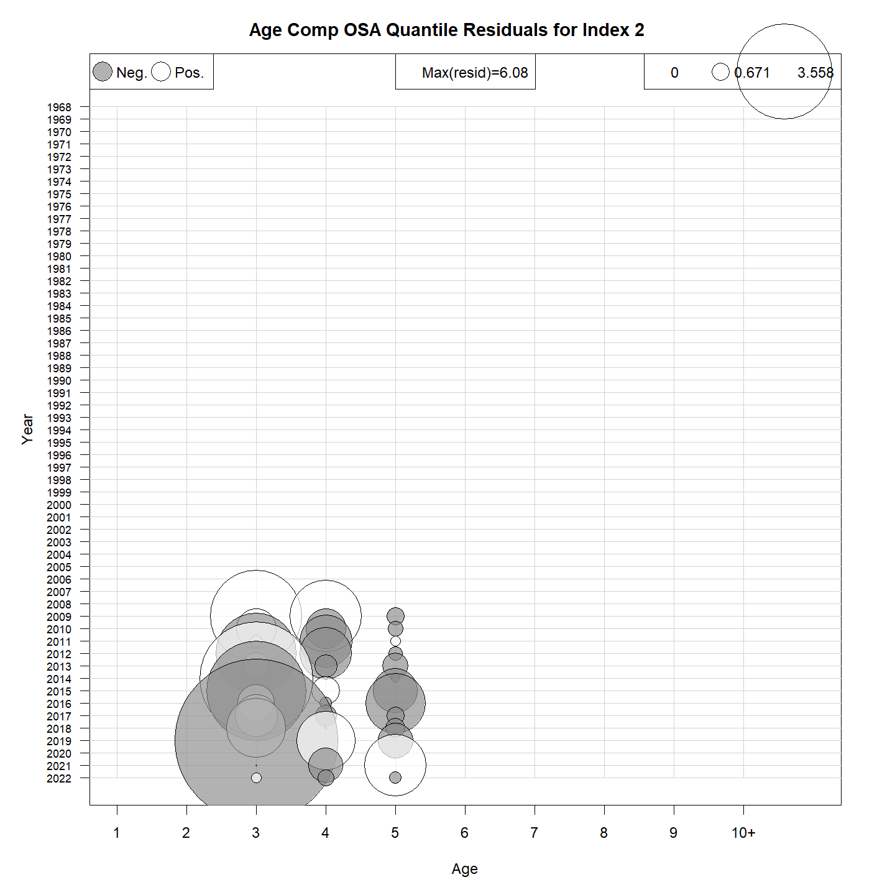
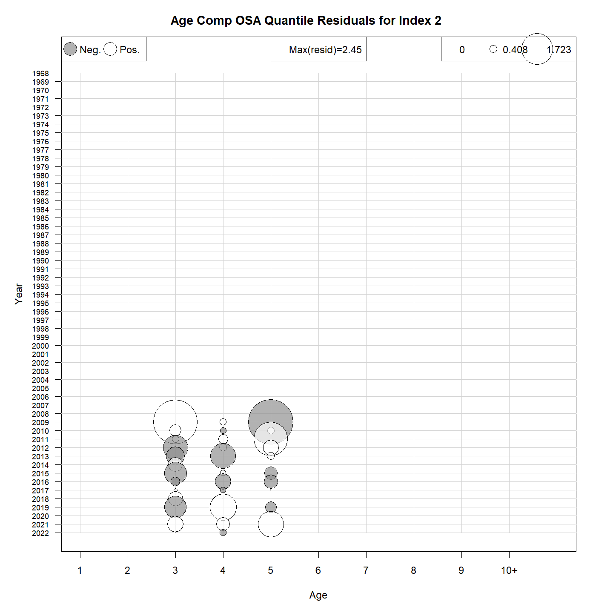
NEFSC Bigelow OSA
Multinomial
Logistic-normal-pool0

Slide 15
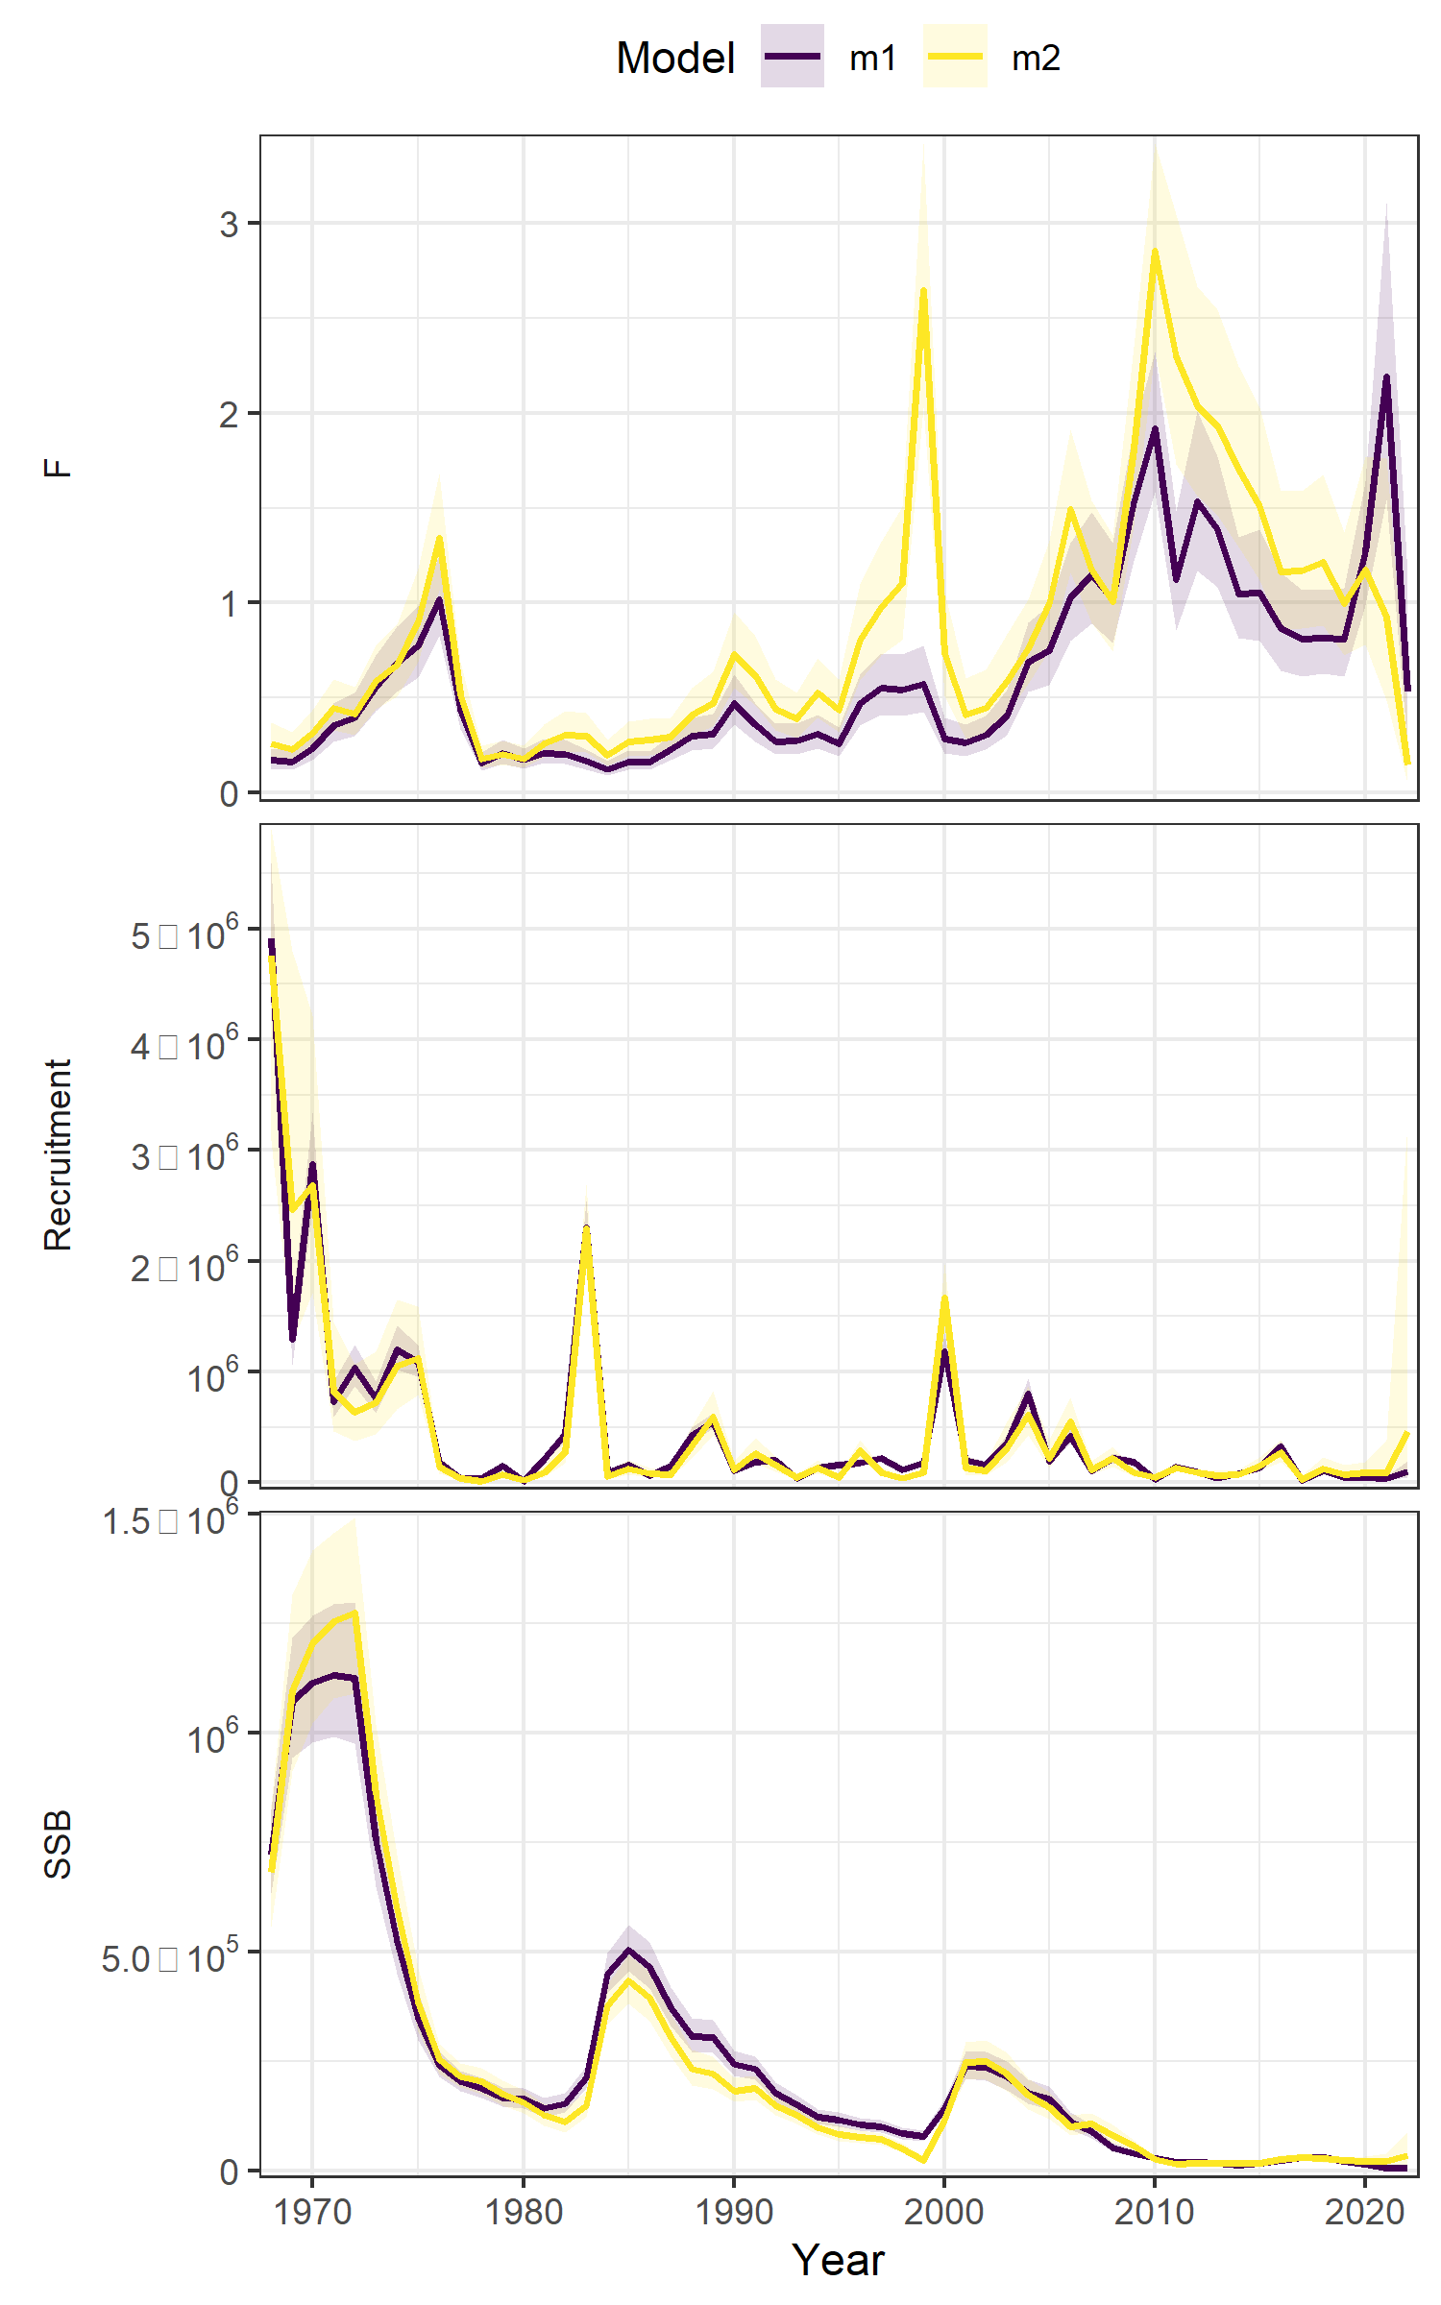
Age comp summary
Moved to logistic-normal
Run | age_comp | rho_R | rho_SSB | rho_Fbar
m1 | multinomial | 0.1608 | 0.3633 | -0.228
m2 | logistic-normal-miss0 | 0.7369 | 0.7068 | -0.2969
Figure 7 WP 10

Slide 16
The plan
ASAP → WHAM
Age-comps
Recruitment
Time varying
Selectivity
NAA

Slide 17
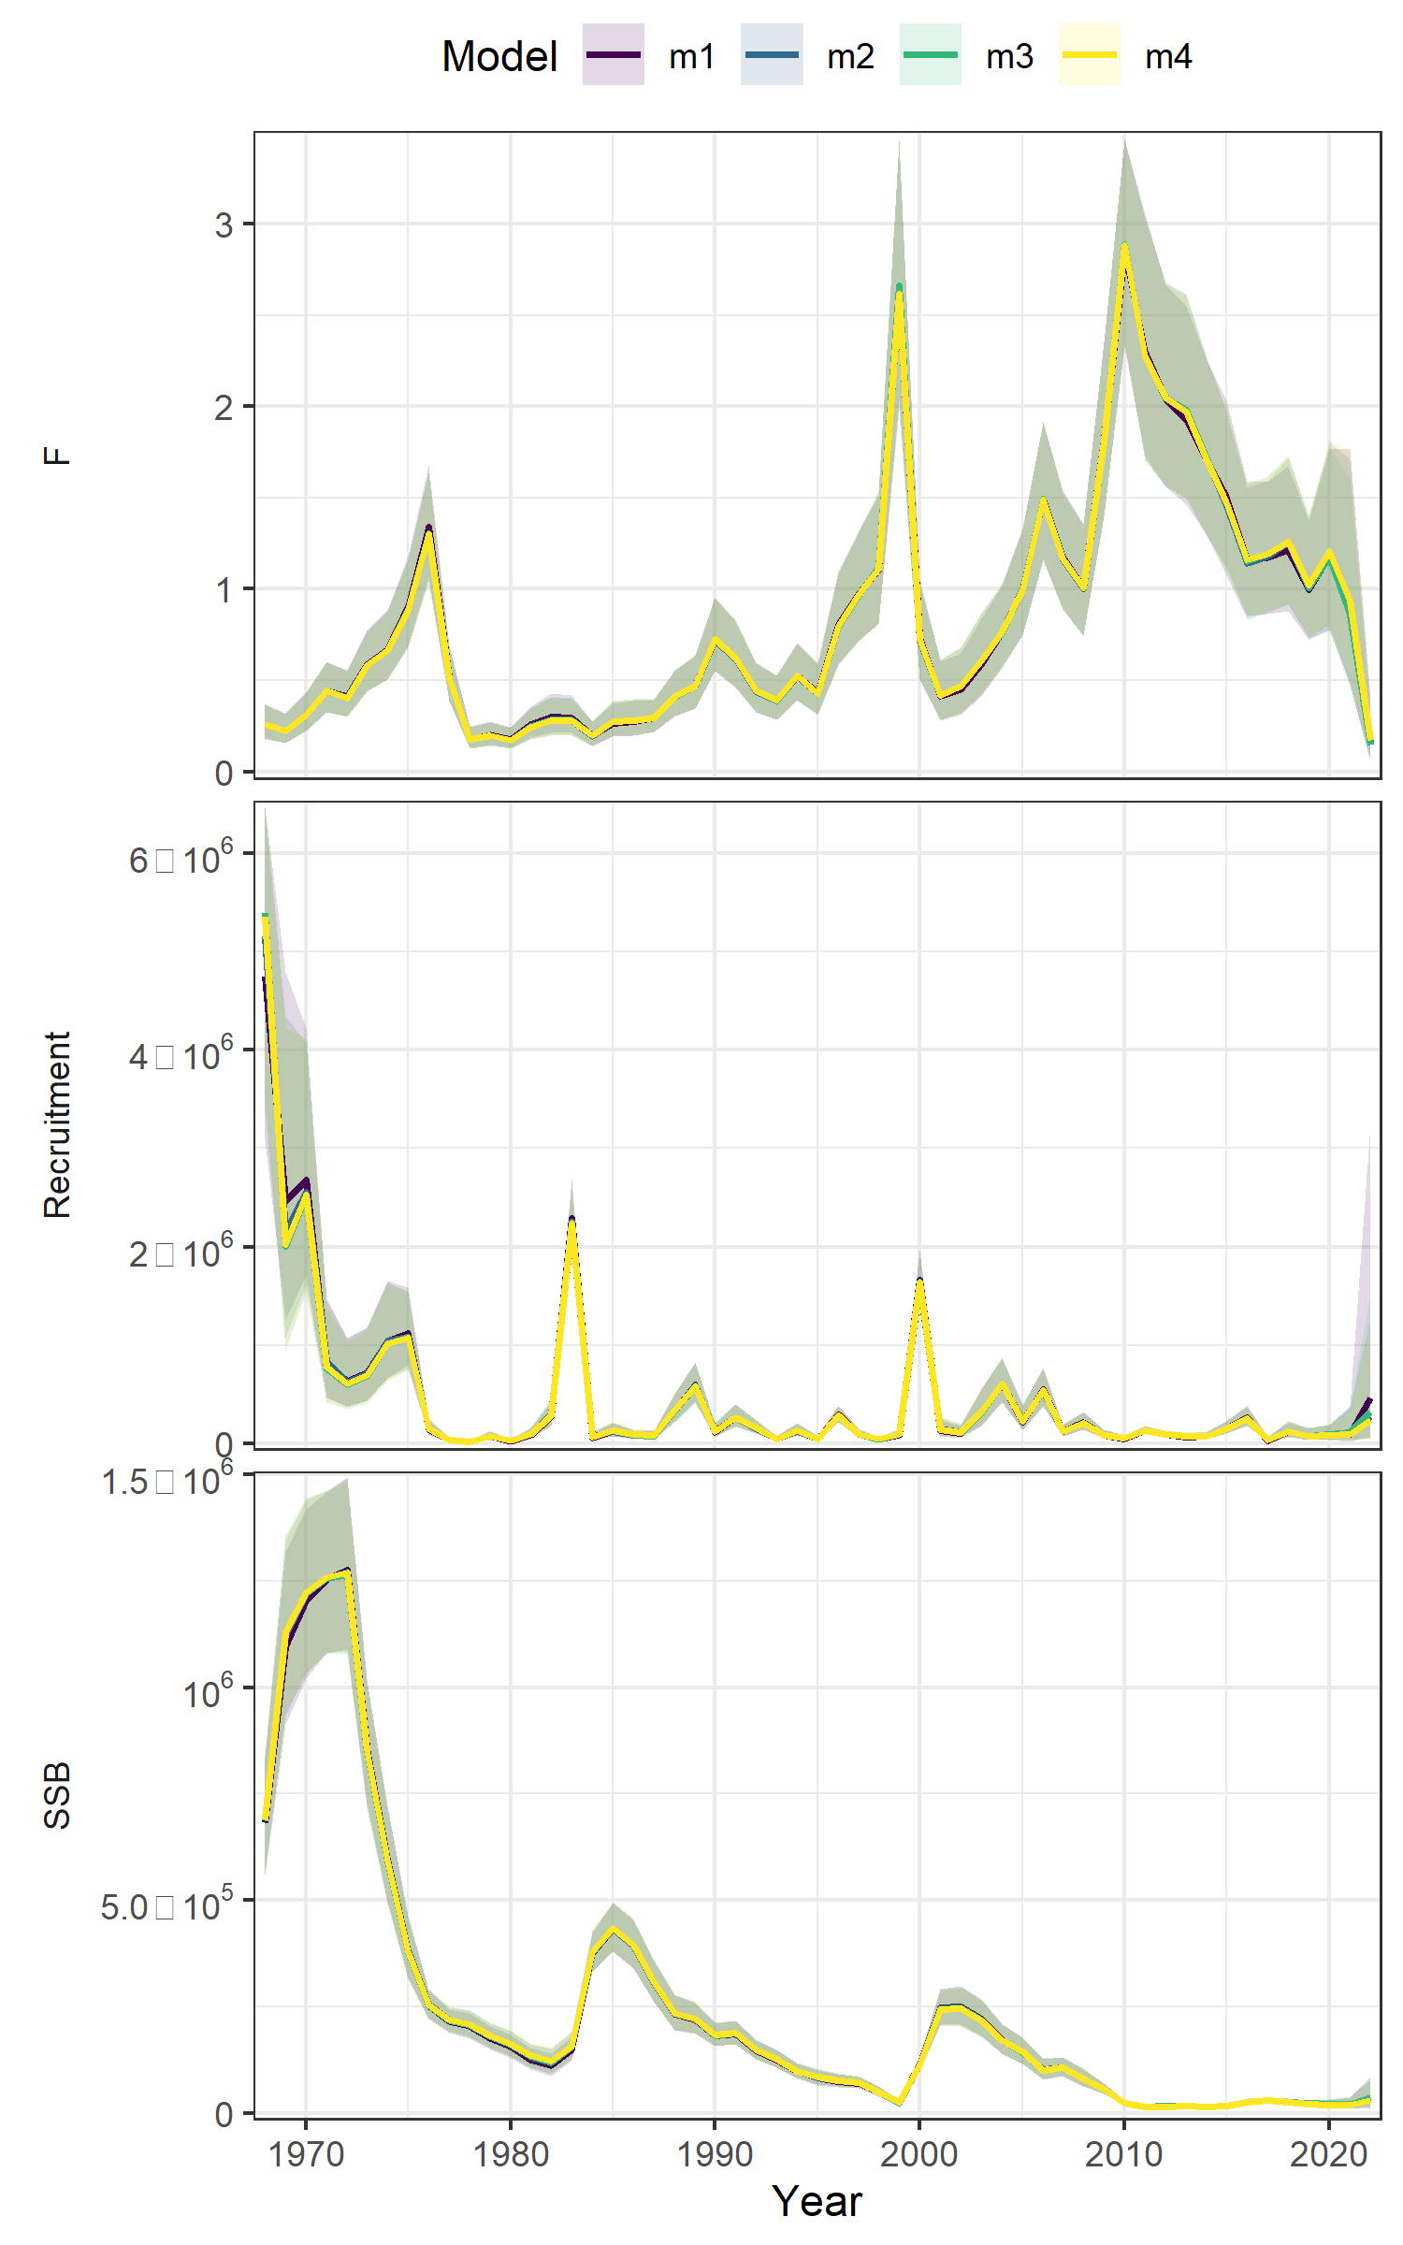
Recruitment
Runs | RE | dAIC | Rho R | Rho SSB | Rho Fbar | MASE egg | MASE Bigelow
m1 | None | 0 | 0.877 | 0.880 | -0.419 | 0.98 | 0.53
m2 | ar1 | 159.1 | 1.068 | 1.132 | -0.498 | 0.852 | 0.491
m3 | iid | 168.6 | 1.223 | 1.309 | -0.542 | 1.14 | 0.648
m4 | Beverton holt | 190.8 | 0.721 | 0.913 | -0.450 | 1.39 | 0.693
Table 2 WP 10
Figure 8 WP 10

Slide 18
The plan
ASAP → WHAM
Age-comps
Recruitment
Time varying
Selectivity
NAA

Slide 19
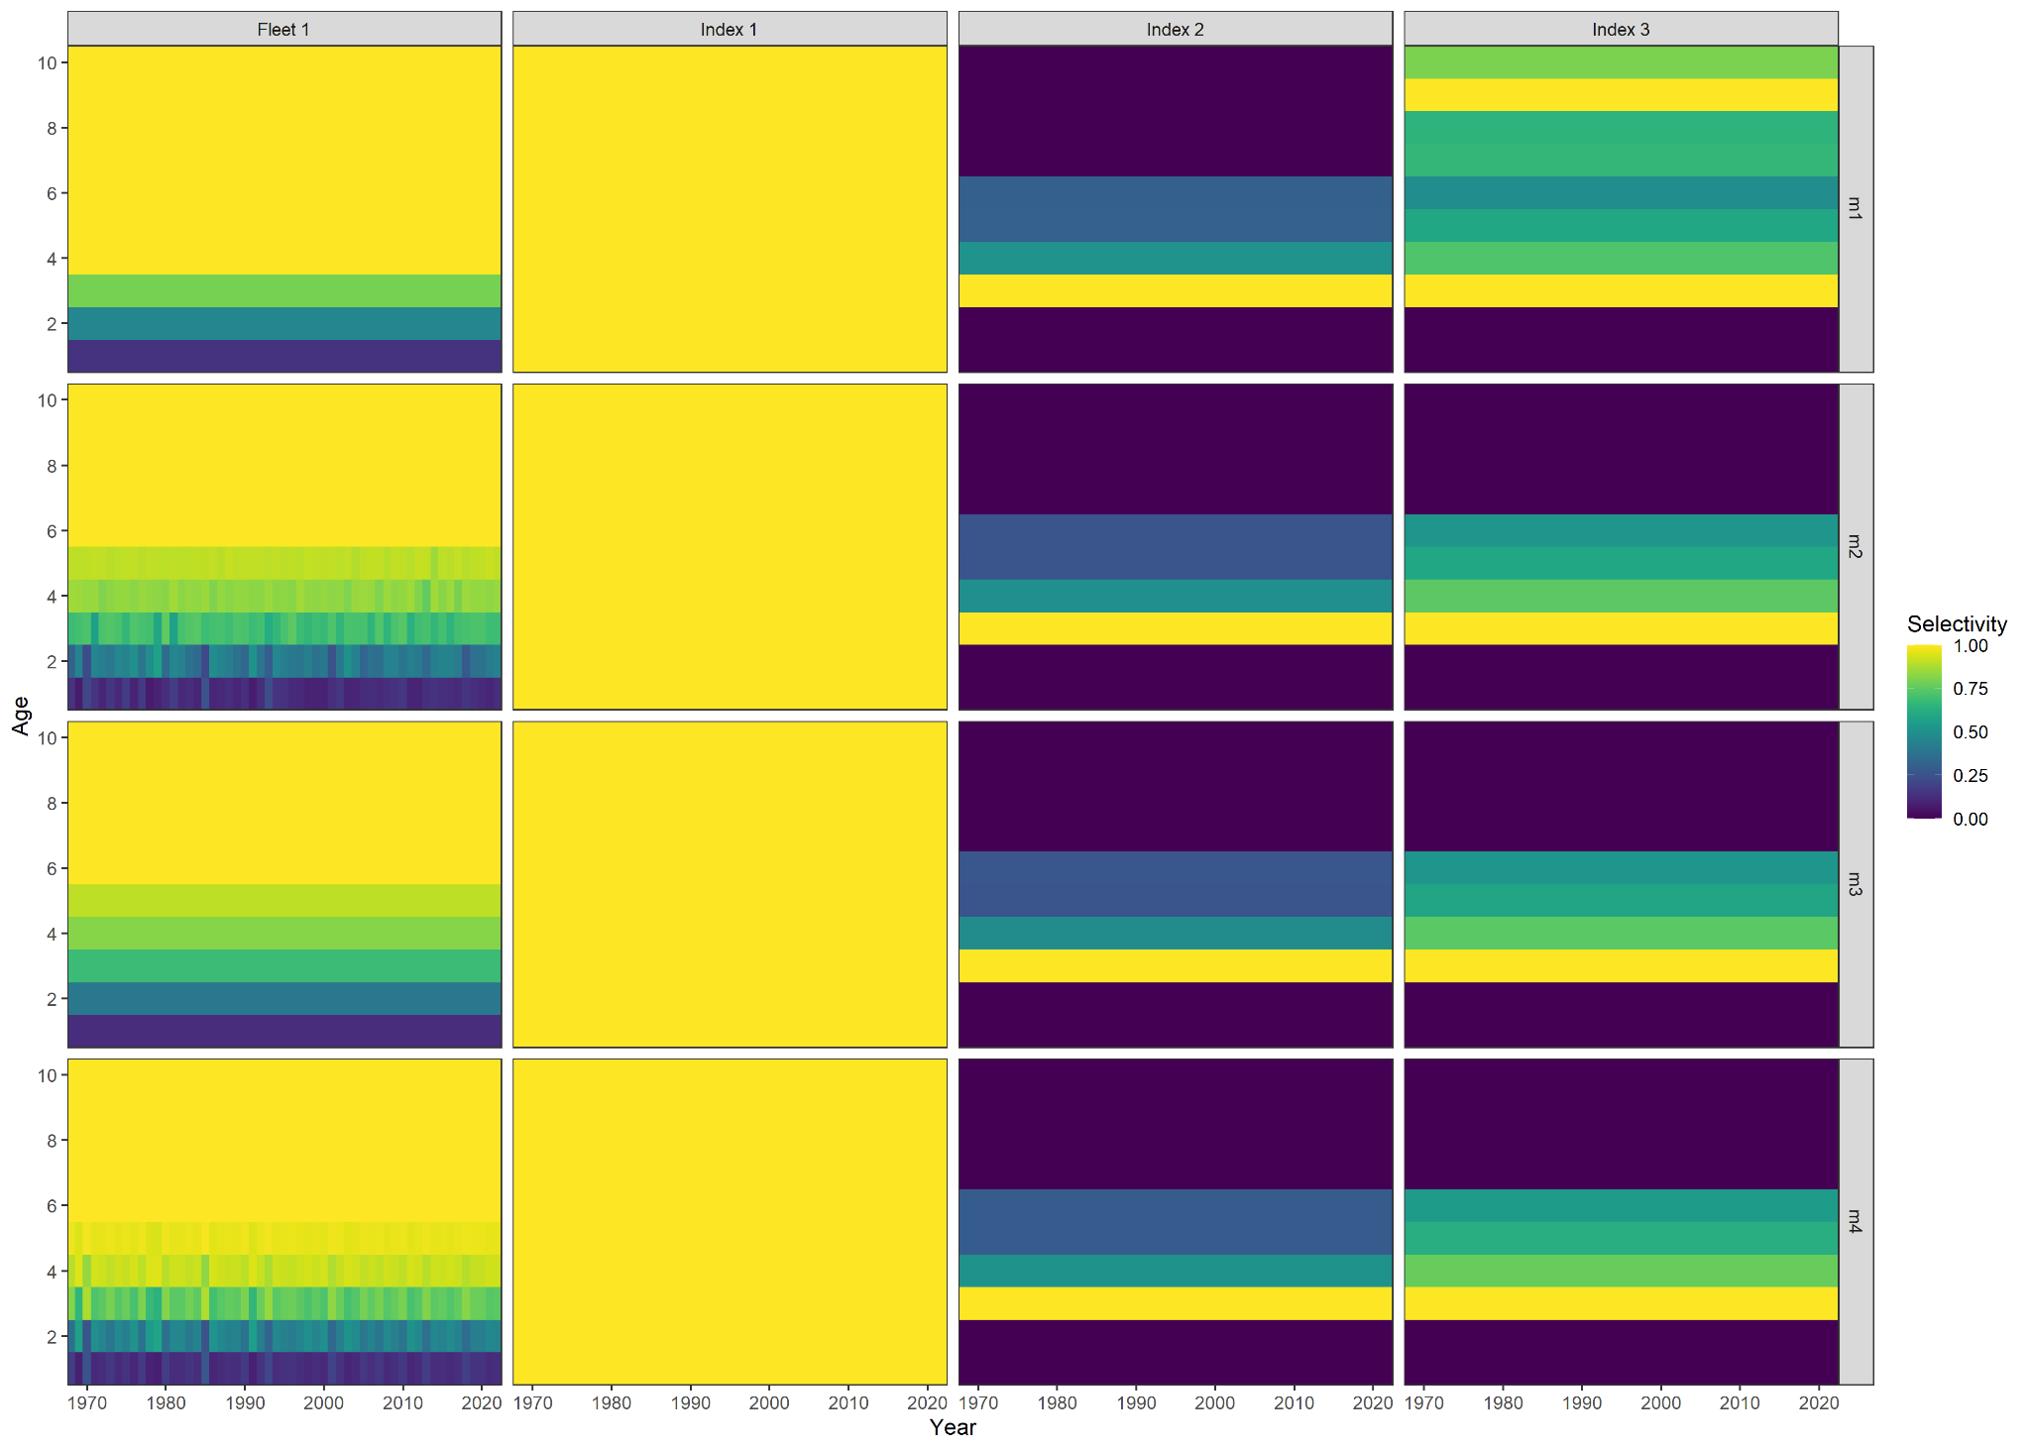
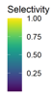
Time varying selectivity
Runs | RE | dAIC | Rho R | Rho SSB | Rho Fbar | Mase egg | MASE Bigelow
m1 | None | 0 | 0.992 | 1.012 | -0.4596 | 0.98 | 0.53
m4 | 2dar-1 | 327.6 | 0.820 | 0.928 | -0.3835 | 1.02 | 0.583
m2 | iid | 330.4 | 0.609 | 0.703 | -0.3622 | 0.964 | 0.562
m3 | ar1_y | 342.2 | 0.877 | 0.880 | -0.4192 | 0.955 | 0.556
Table 3 WP 10
Figure 10 WP 10

Slide 20
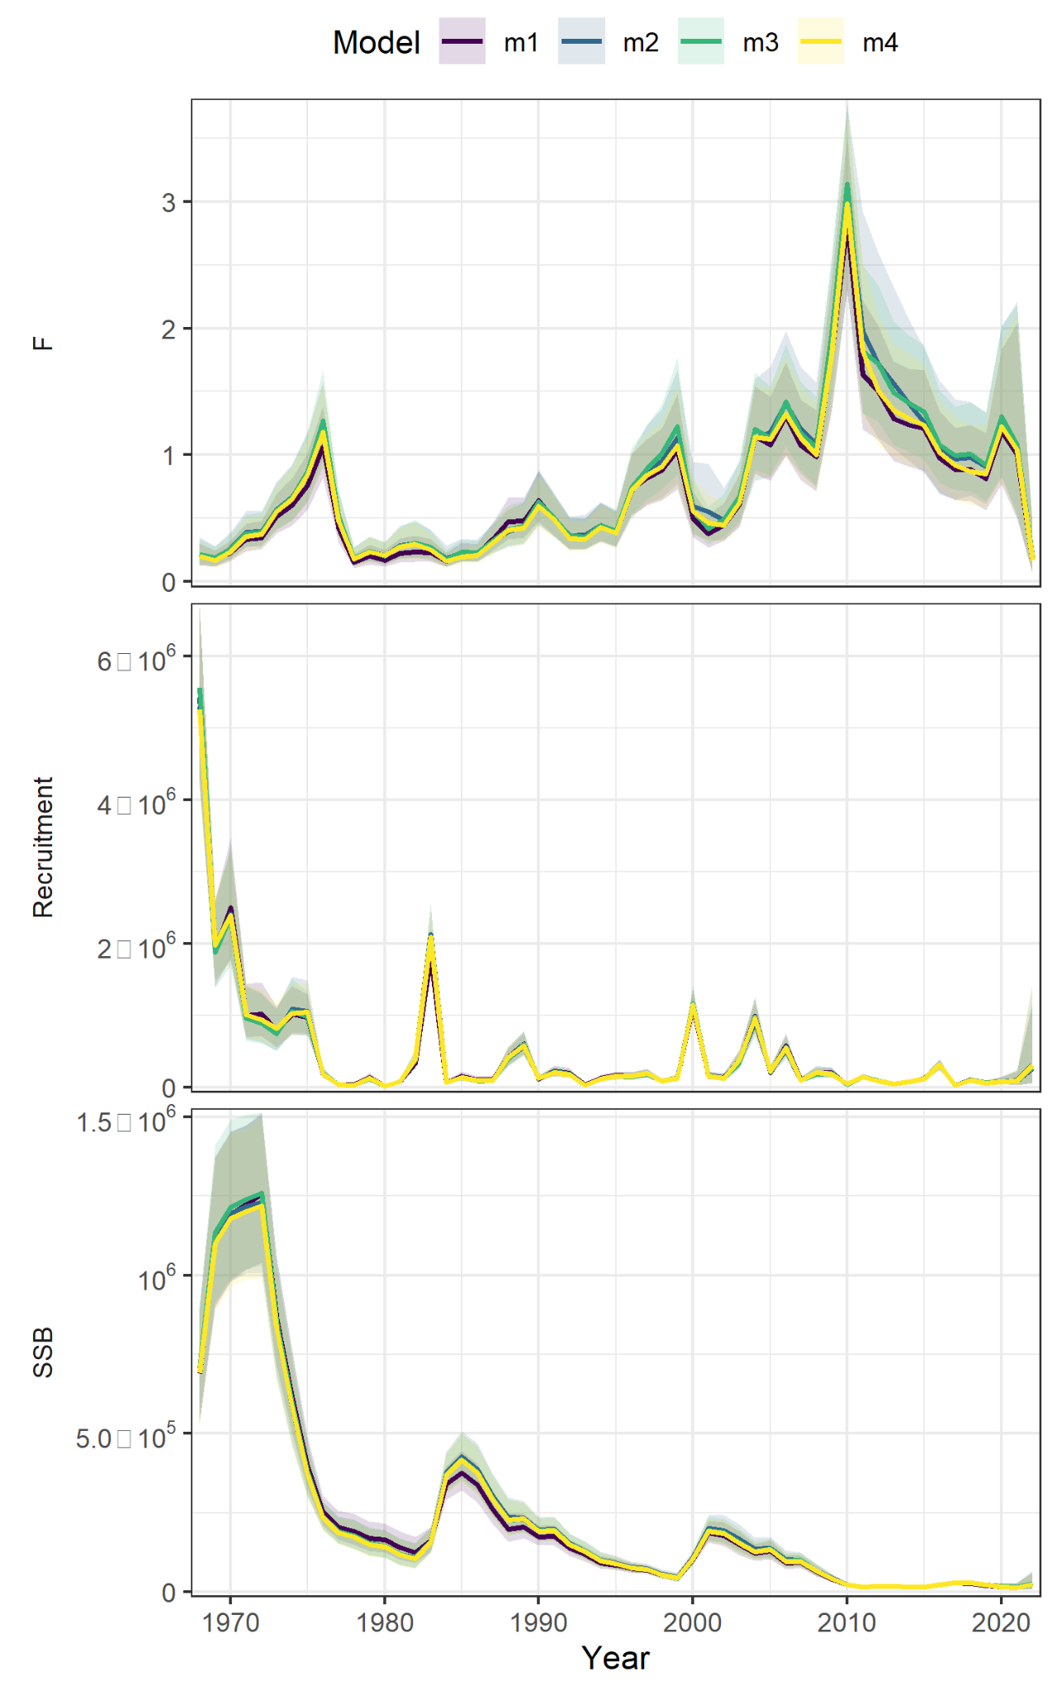
Time varying selectivity
m1 = none; m2 = IID; m3 = AR1_y; m4 = 2DAR1
Figure 9 WP 10

Slide 21

The plan
ASAP → WHAM
Age-comps
Recruitment
Time varying
Selectivity
NAA

Slide 22
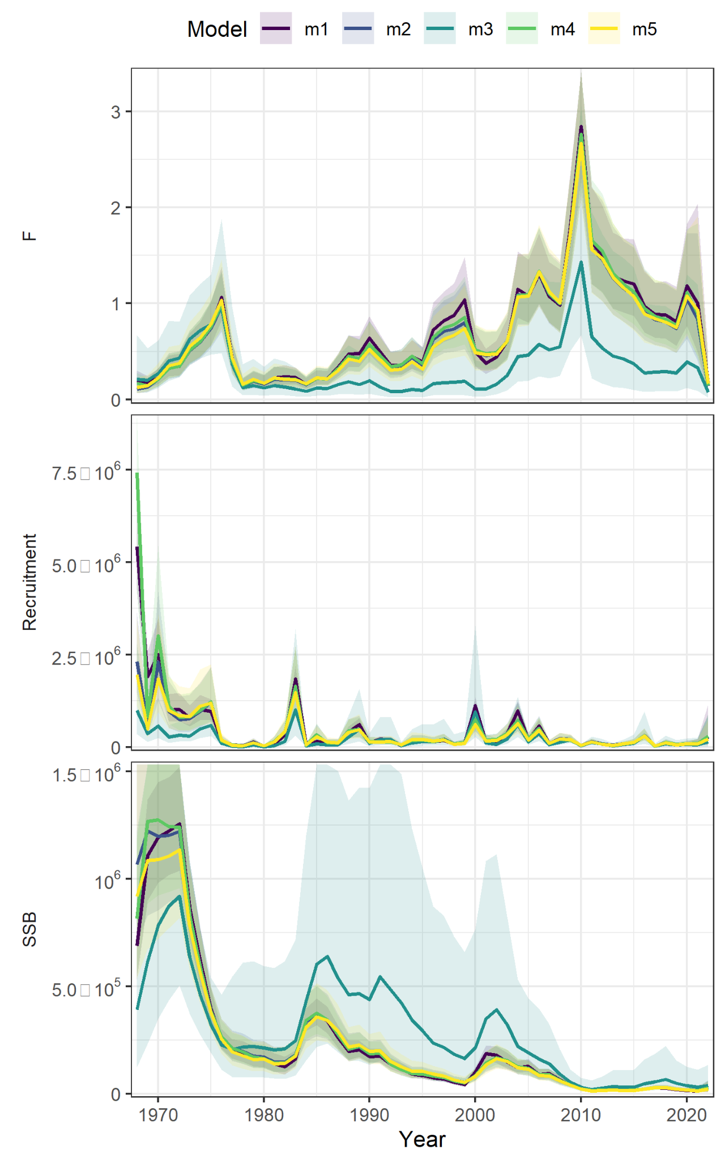
Random effects on NAA
Model | RE | dAIC | Rho R | Rho SSB | Rho Fbar | MASE egg | MASE Bigelow
m1 | none | 0 | 0.992 | 1.012 | -0.459 | 0.98 | 0.53
m4 | ar1_a | 152 | 1.090 | 1.231 | -0.535 | 0.91 | 0.47
m5 | ar1_y | 190.8 | 0.721 | 0.913 | -0.450 | 0.906 | 0.477
m2 | iid | 208.9 | 0.96 | 1.167 | -0.518 | 1.01 | 0.50
m3 | 2dar1 | 214.2 | 0.251 | 0.280 | -0.162 | 1.49 | 0.832
Table 3 WP 10
Figure 13 WP 10

Slide 23
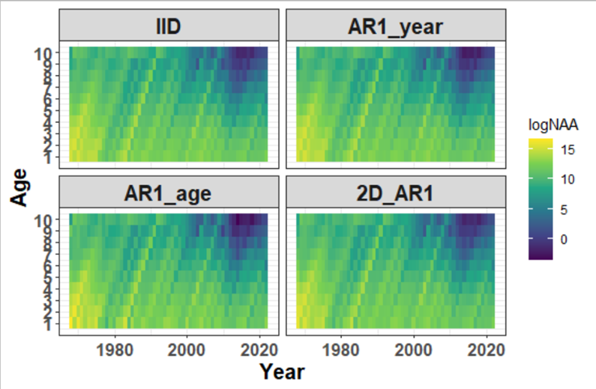
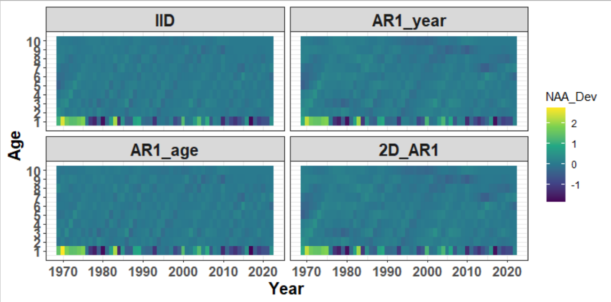
Random effects on NAA
Numbers at age
Deviations in numbers at age
Figure 11 WP 10
Figure 12 WP 10

Slide 24
Data inputs
ASAP
Ages 1-10+
Catch at age (1968-2022)
Surveys:
NEFSC spring (Albatross 1968-2008)
NEFSC spring (Bigelow 2009-2022)
Egg survey (1983-1987; 2000-2022)
Natural mortality = 0.2
WHAM
Logistic-normal-ar1-miss0
2dar1 on NAA

Slide 25
Selectivity
Block 1 = Catch
Block 2 = Egg index
Block 3 = Albatross
Block 4= Bigelow

Slide 26
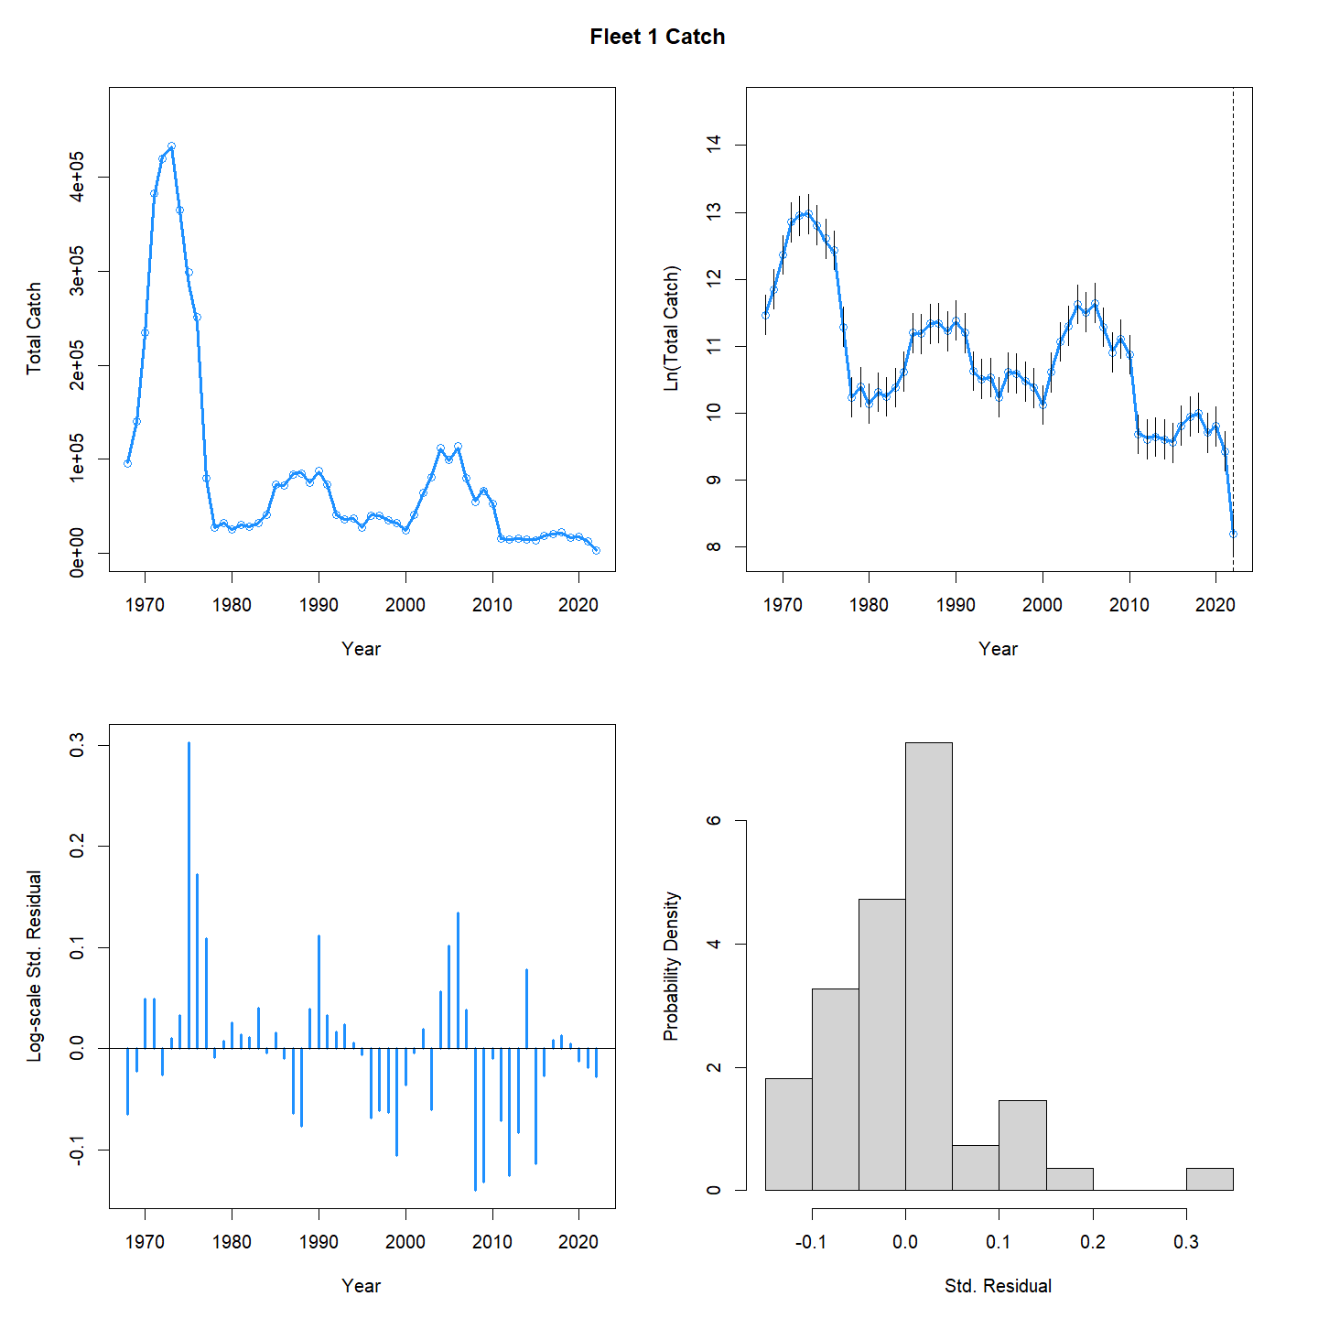
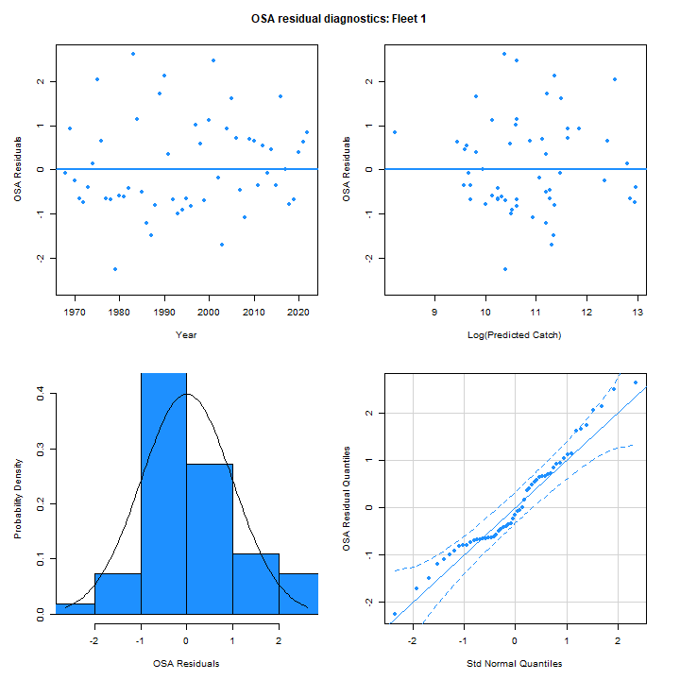
Catch aggregate fit
Figure 14 WP 10

Slide 27
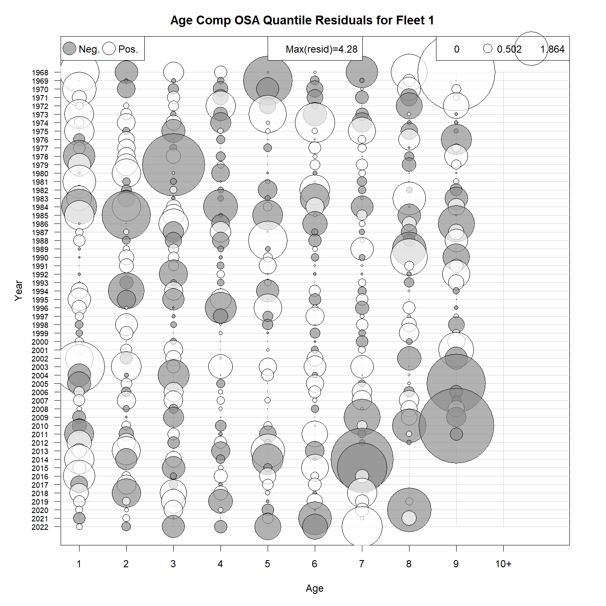
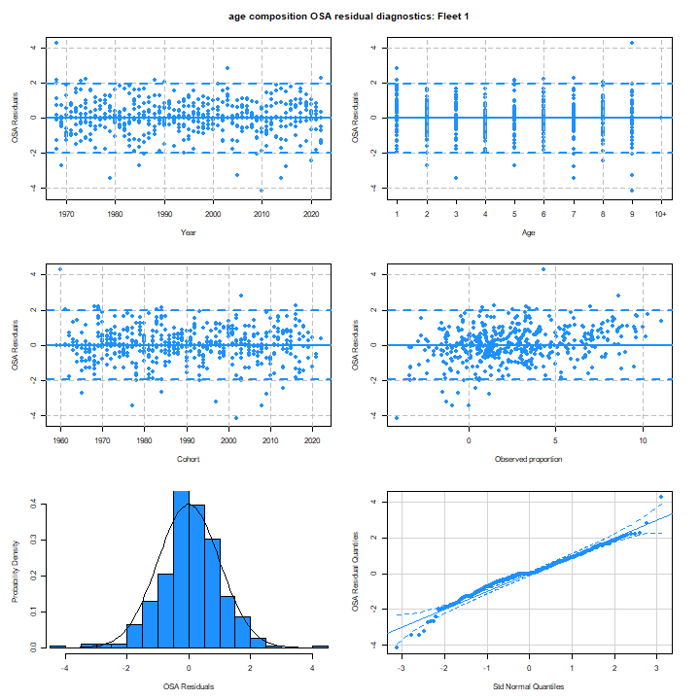
Catch age composition OSA
Figure 18 WP 10

Slide 28
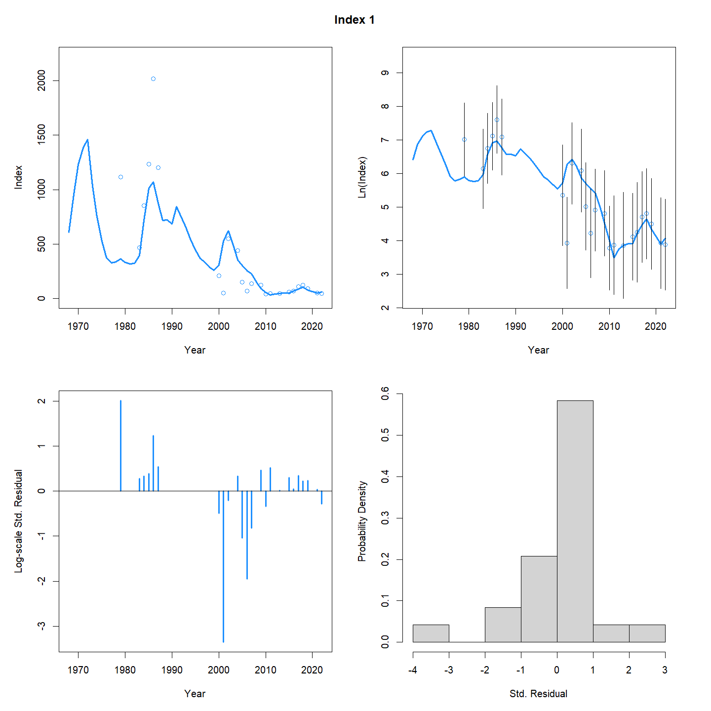
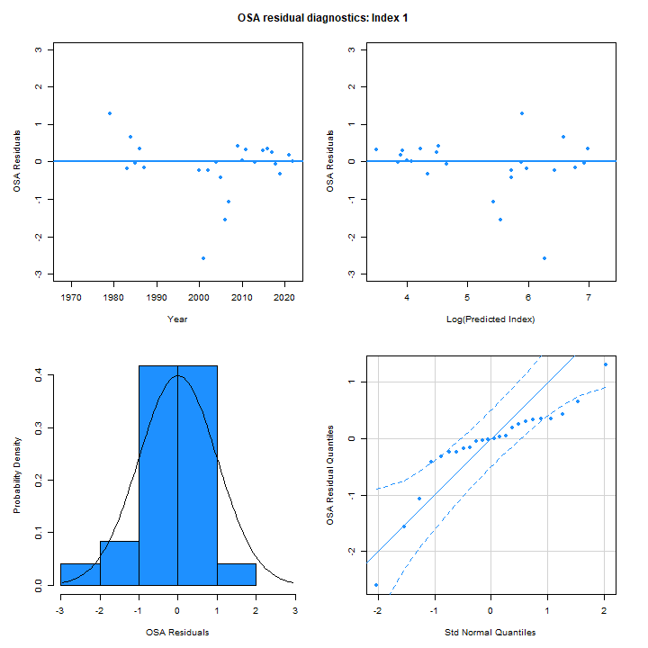
Egg survey aggregate fit
Figure 15 WP 10

Slide 29
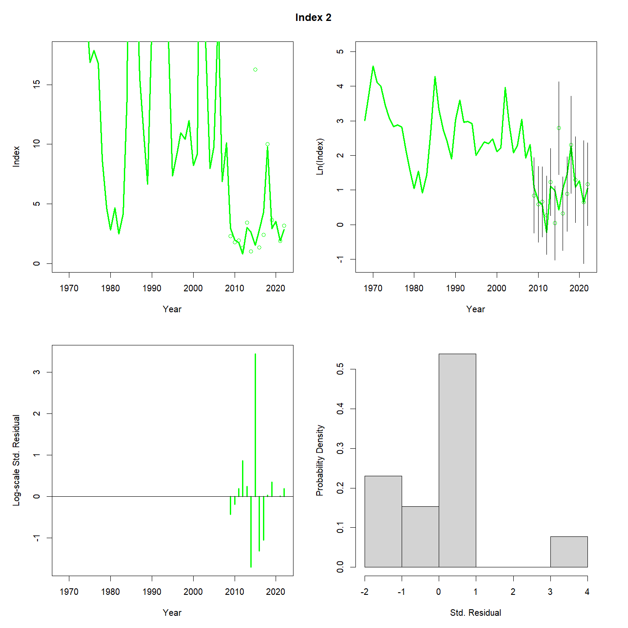
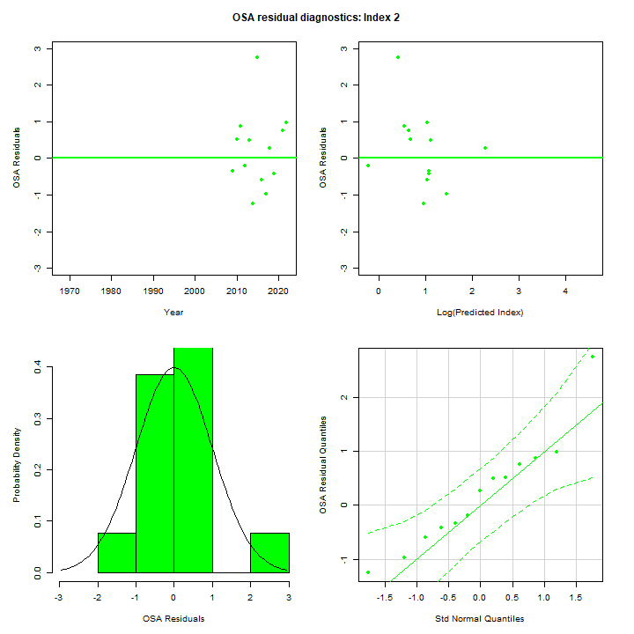
Bigelow survey aggregate fit
Figure 16 WP 10

Slide 30
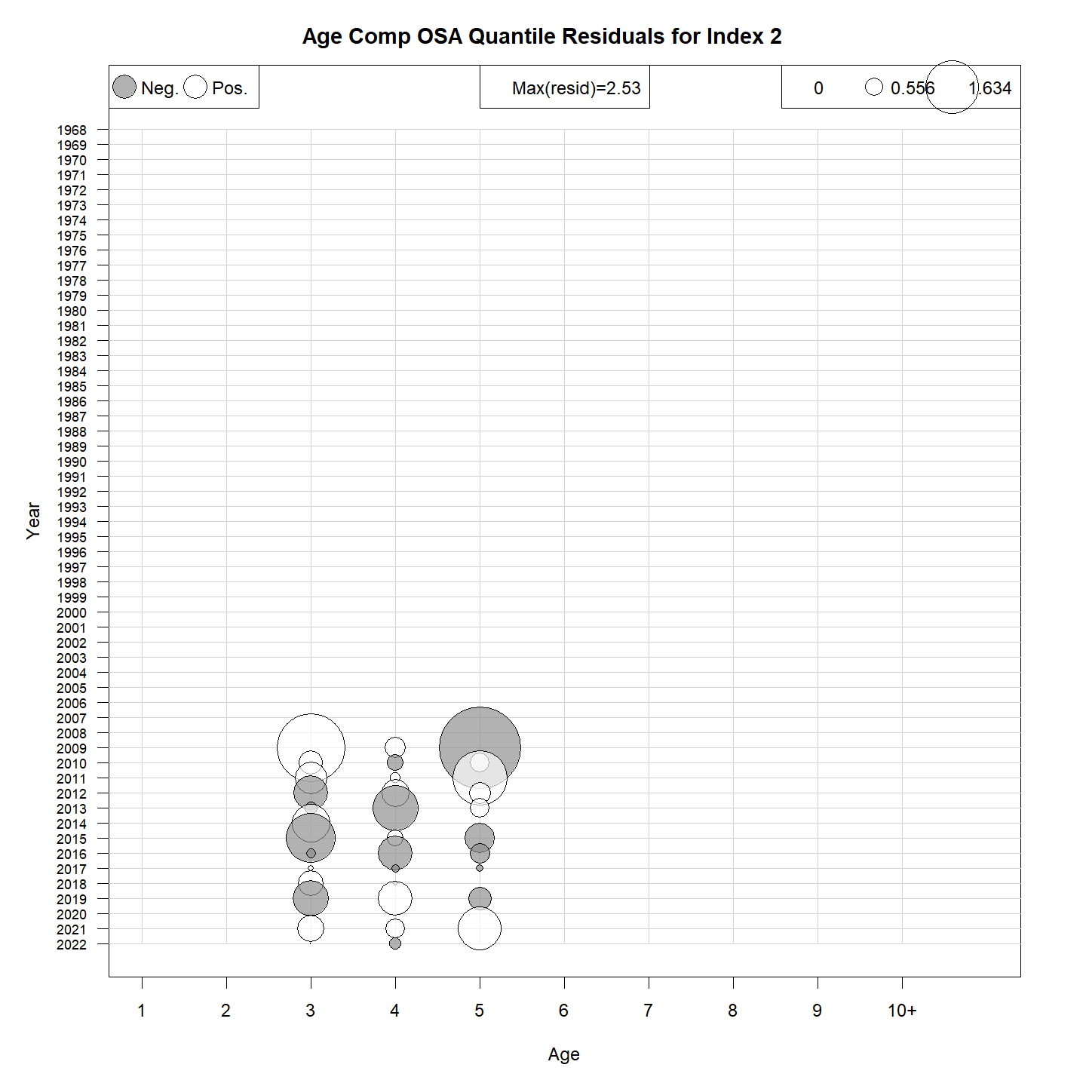
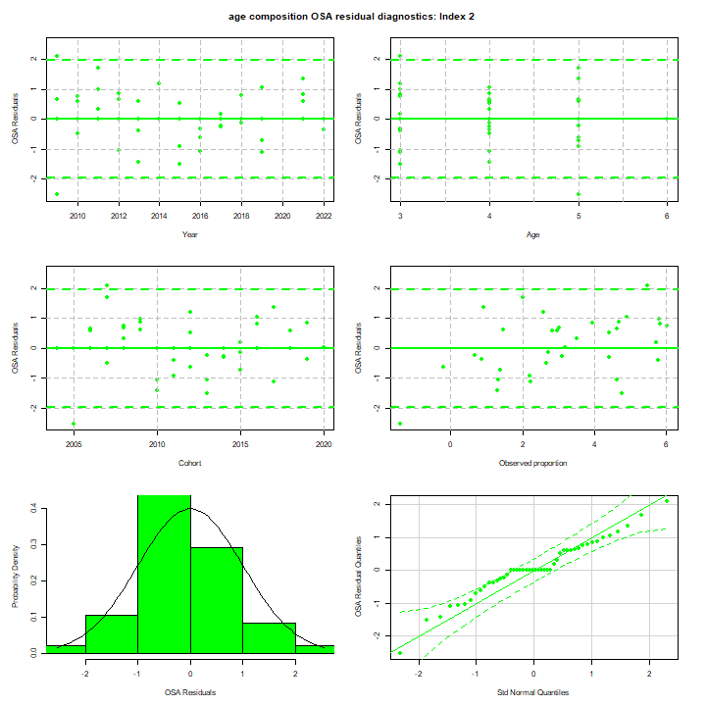
Bigelow age comps OSA
Figure 20 WP 10

Slide 31
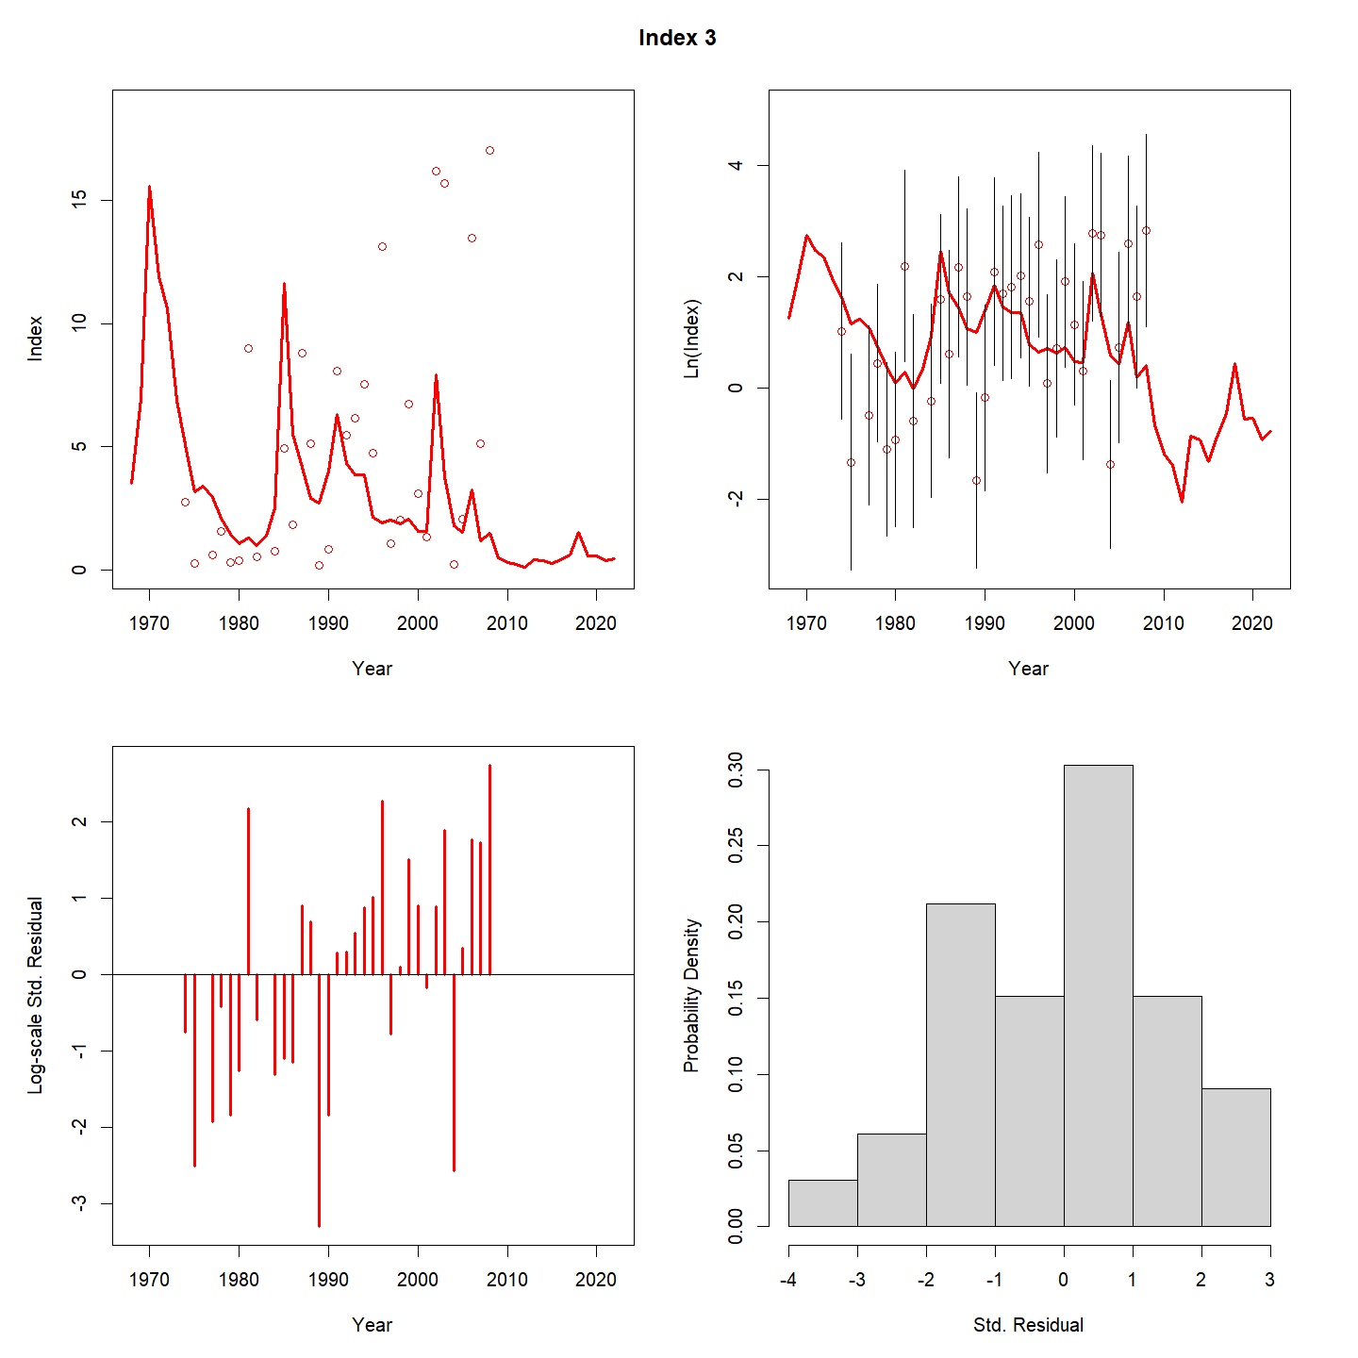
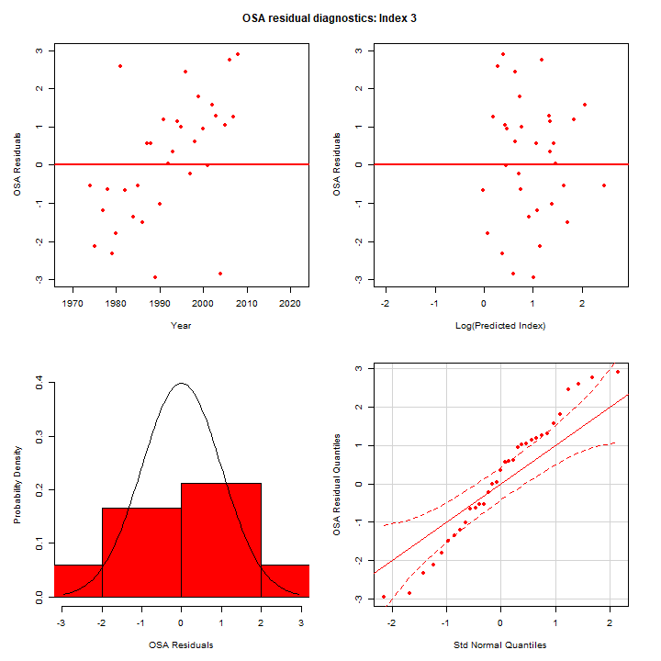
Albatross survey aggregate fit
Figure 17 WP 10

Slide 32
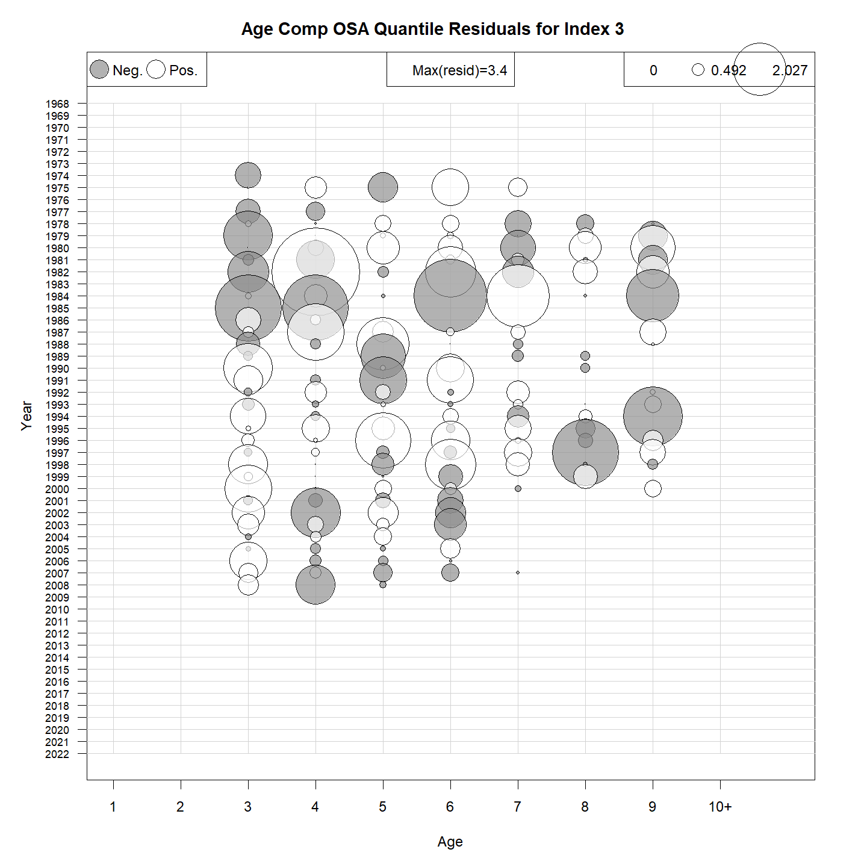
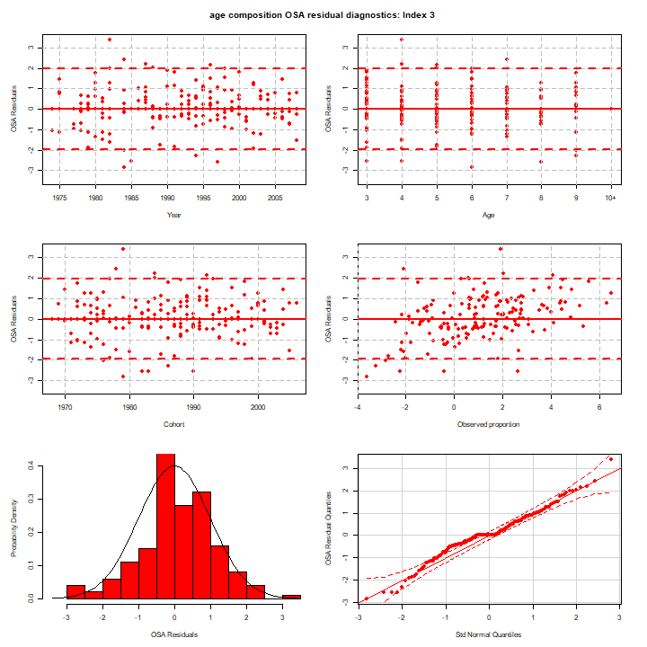
Albatross age comps OSA
Figure 19 WP 10

Slide 33
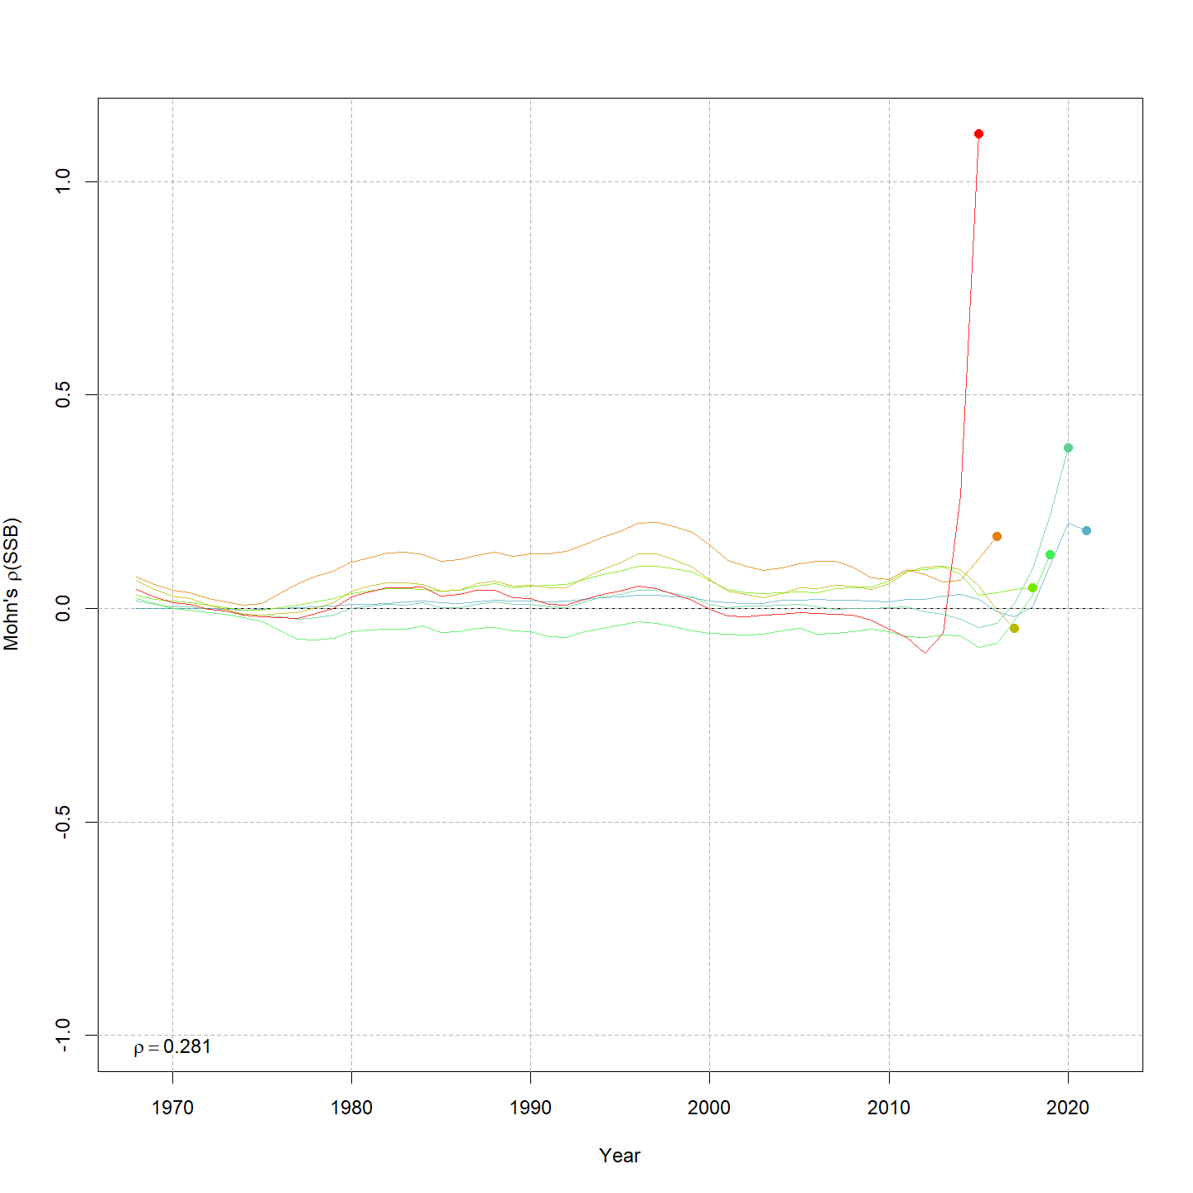
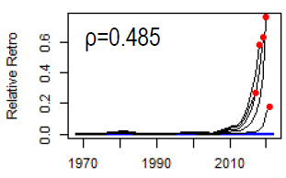
Retro: SSB
ASAP
WHAM
Figure 21 WP 10

Slide 34
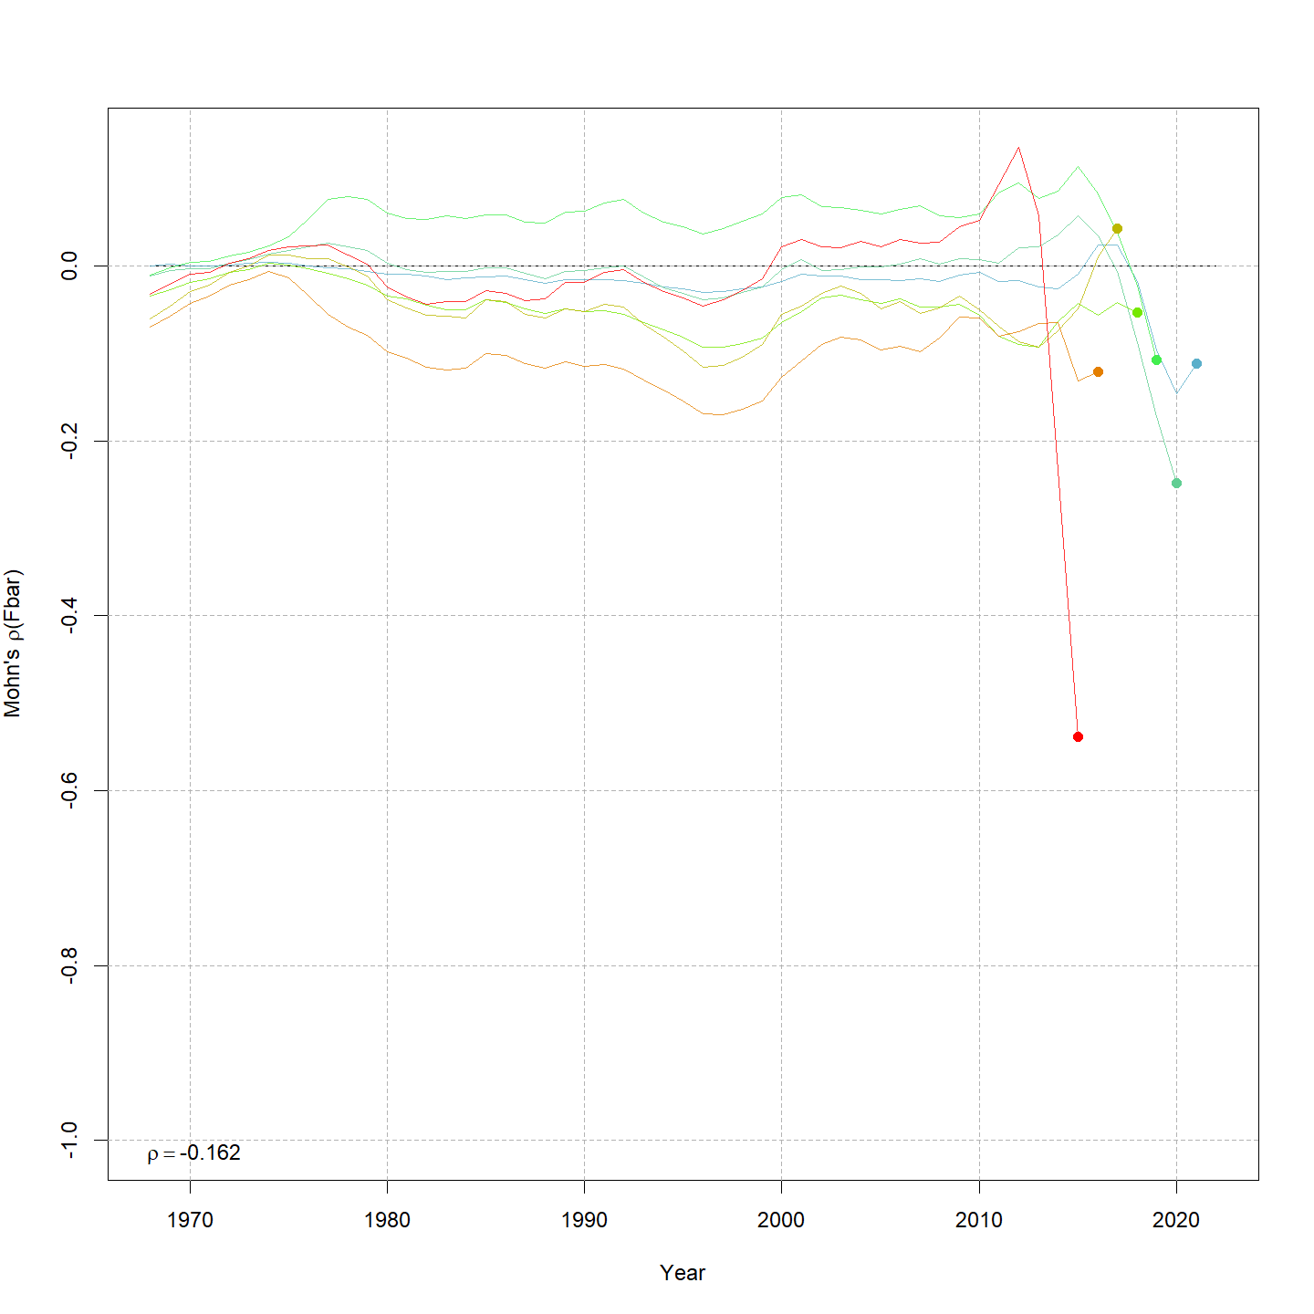
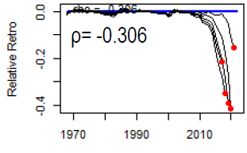
Retro: F
ASAP
WHAM
Figure 21 WP 10

Slide 35
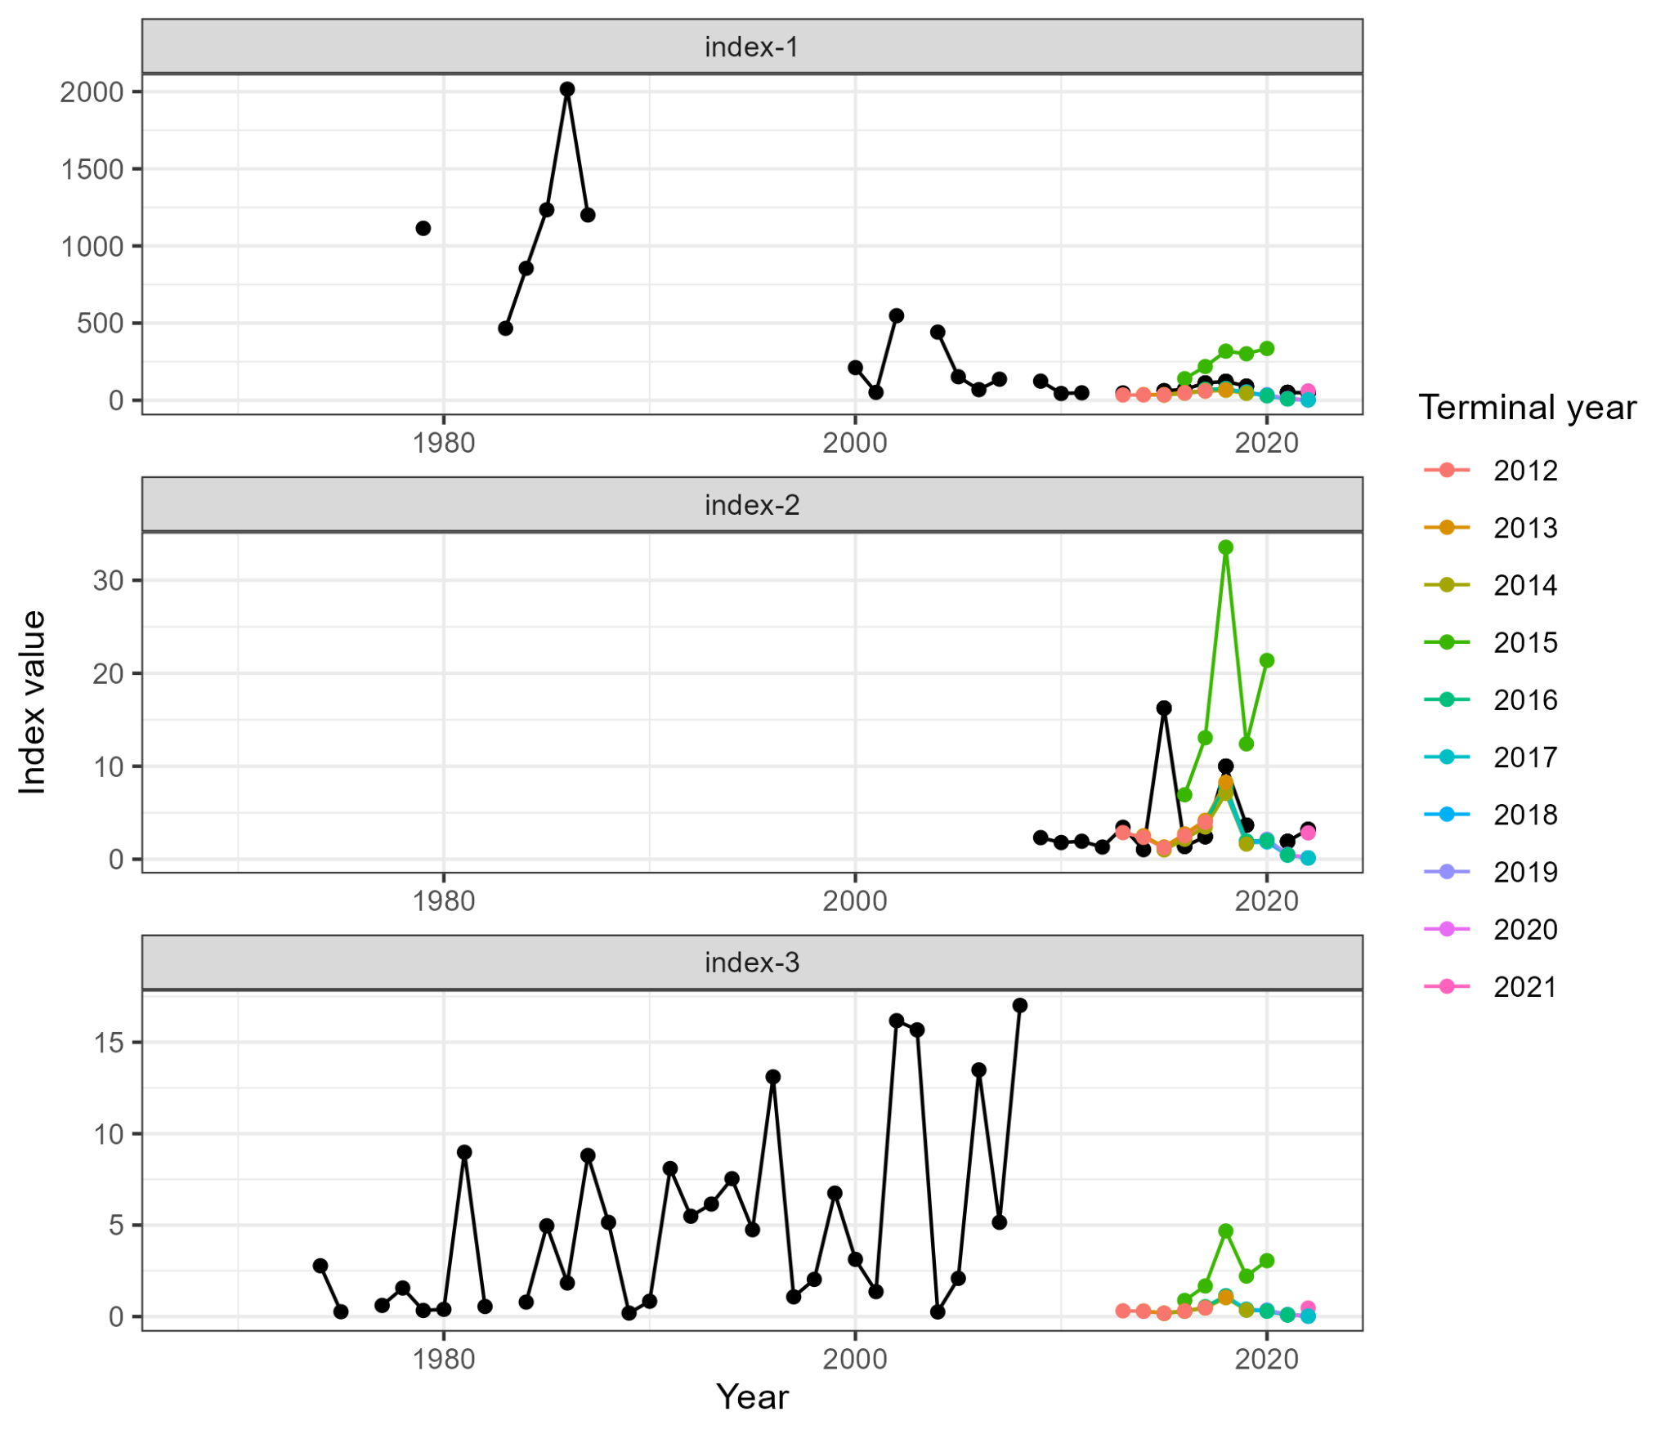
MASE
NEFSC Bigelow | Egg Survey
0.832 | 1.49
Table 5 WP 10
Figure 22 WP 10

Slide 36
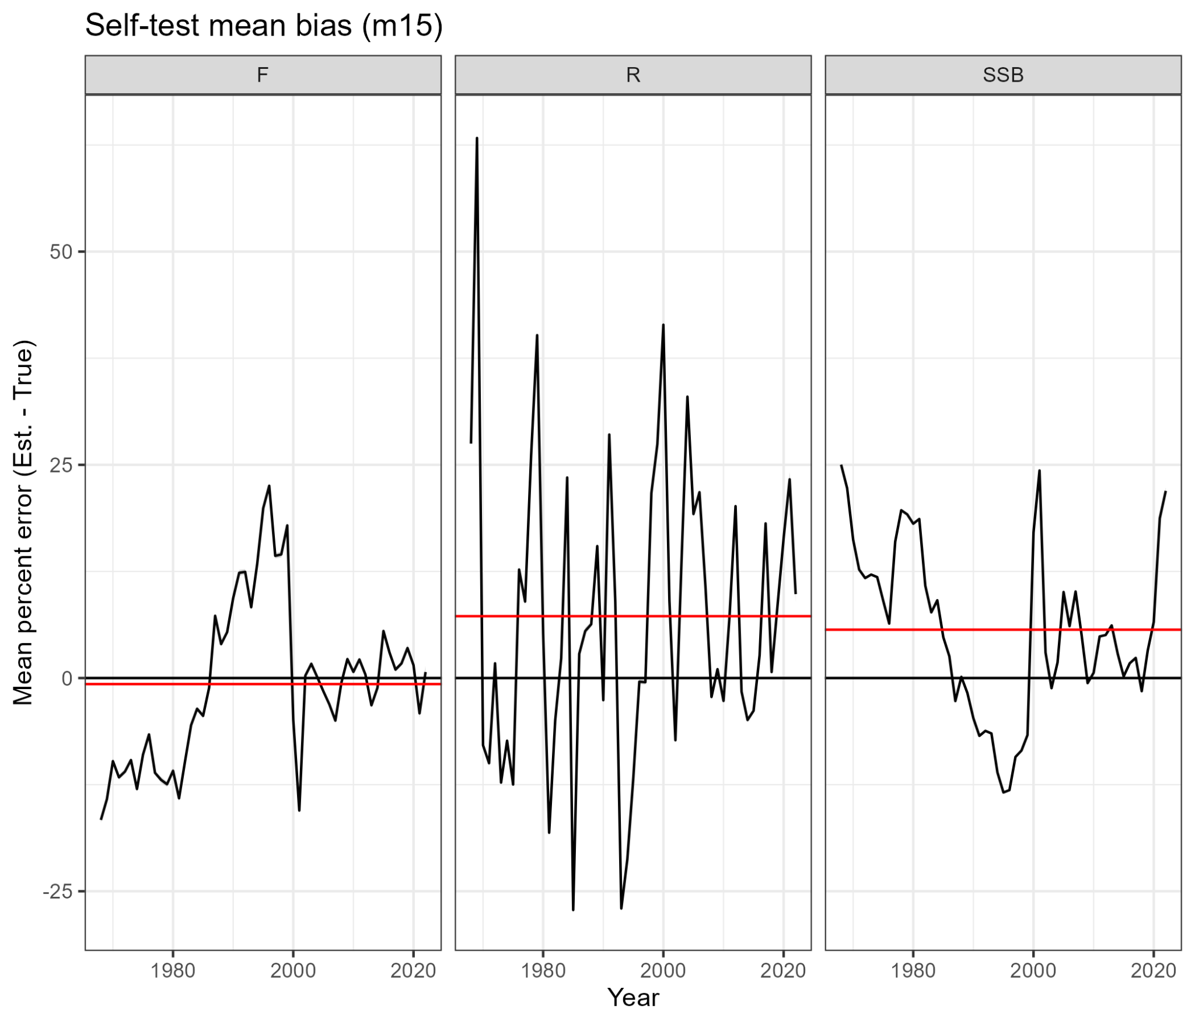
Self-test
VAR | Mean Percent Bias
F | -0.71
R | 7.25
SSB | 5.67
Table 6 WP 10
Figure 23 WP 10

Slide 37
Diagnostic Summary
Similar fits to aggregate time series
Good fits to age comps
Retros are better in WHAM
Poor prediction skill for the egg survey
Passes self-test
Mohns rho
VAR | ASAP | WHAM
F | -0.306 | 0.162
SSB | 0.485 | 0.281
R | 0.132 | 0.251

Slide 38
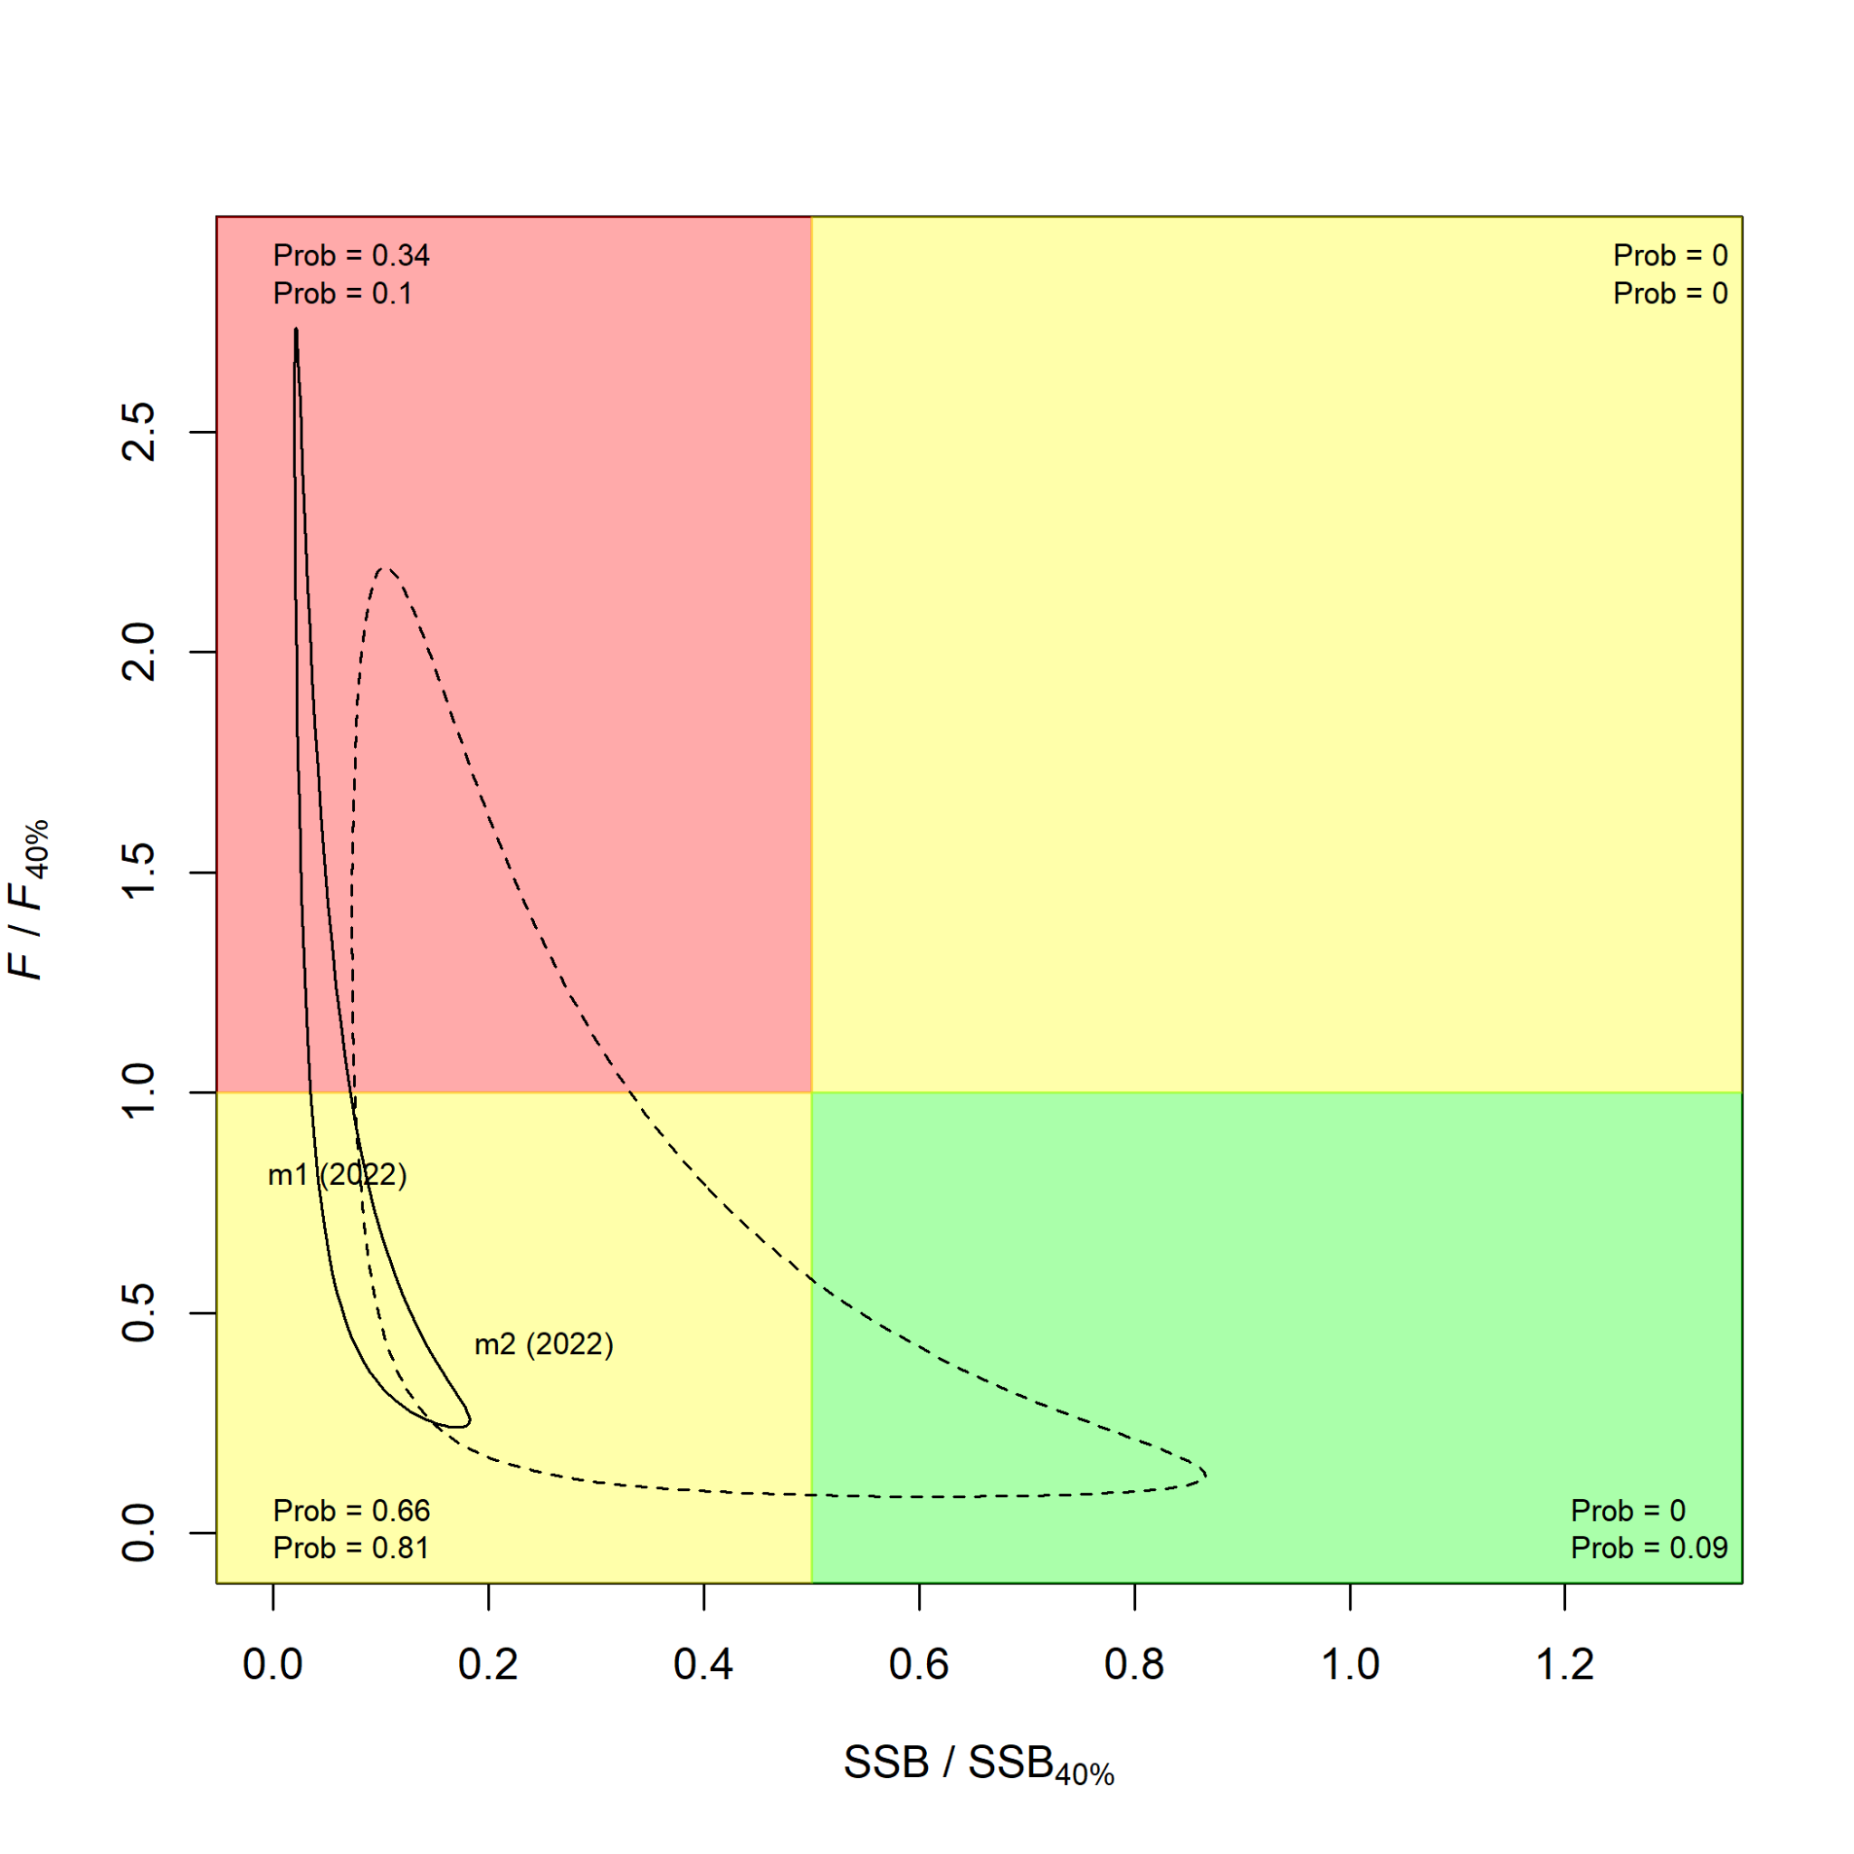
Biological reference points
M1 = ASAP
M2 = WHAM
 | ASAP | WHAM
F40% | 0.21 | 0.16
SSB40% | 154,107 (86,490 – 332,677) | 128,150 (49,587-331,184)
Yield40% | 30,460 (17,321 – 63,448) | 23,724 (9,123 – 61,693)
Table 7 WP 10
Figure 24 WP 10

Slide 39
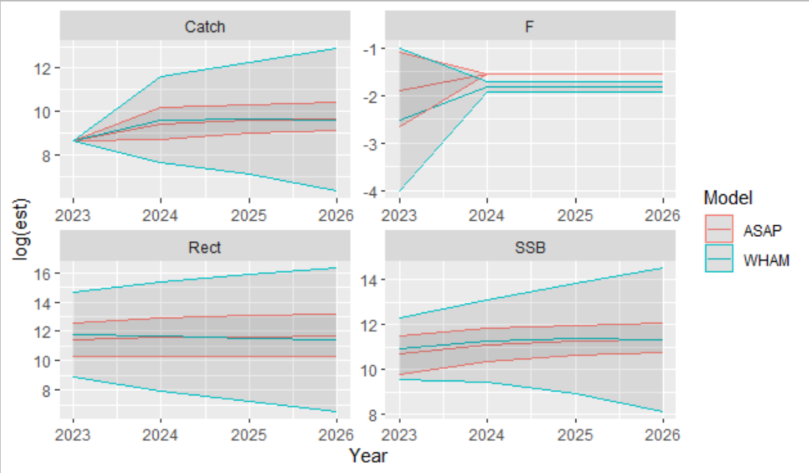
Projections
Year | Par | WHAM | lo | hi | ASAP | lo | hi
2023 | SSB | 56696 | 14159 | 227025 | 43721 | 17764 | 100647
2024 | SSB | 79974 | 12770 | 500858 | 67524 | 32341 | 143307
2025 | SSB | 87139 | 7424 | 1022820 | 77038 | 43184 | 156933
2026 | SSB | 83319 | 3395 | 2044805 | 81551 | 47719 | 176672
2023 | F | 0.081 | 0.018 | 0.37 | 0.15 | 0.07 | 0.34
2024 | F | 0.163 | 0.147 | 0.181 | 0.21 | 0.21 | 0.21
2025 | F | 0.163 | 0.147 | 0.181 | 0.21 | 0.21 | 0.21
2026 | F | 0.163 | 0.147 | 0.181 | 0.21 | 0.21 | 0.21
2023 | Catch | 5953 | 5953 | 5953 | 5953 | 5953 | 5953
2024 | Catch | 15429 | 2162 | 110092 | 12618 | 6127 | 27331
2025 | Catch | 16285 | 1234 | 214936 | 14671 | 8301 | 30242
2026 | Catch | 15422 | 571 | 416762 | 15694 | 9268 | 33414
2023 | Rect | 131200 | 7204 | 2389543 | 91342 | 28584 | 294287
2024 | Rect | 115979 | 2853 | 4714488 | 107496 | 29362 | 405817
2025 | Rect | 102721 | 1329 | 7940735 | 111252 | 29651 | 470921
2026 | Rect | 91150 | 683 | 12168829 | 116499 | 29937 | 524124
Figure 26 WP 10
Table 8 WP 10

Slide 40
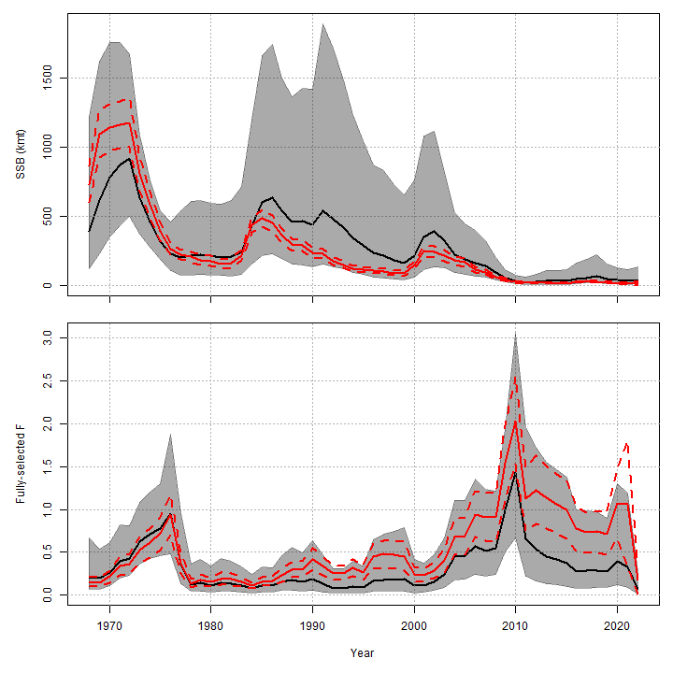
ASAP to WHAM
ASAP
WHAM
Figure 25 WP 10

Slide 41
Summary
Takeaways
Research recommendations
WHAM run:
logistic-normal-ar1-miss0 for fleet and surveys
2dar1 on NAA
WHAM had decent diagnostics
WHAM had improved retros
Minor differences BRPs and projections
High level of process error for numbers at age
Time varying survey catchability and selectivity
Time varying M
Projection assumptions

Slide 42
Back pocket slides

Slide 43
Asap like run

Slide 44
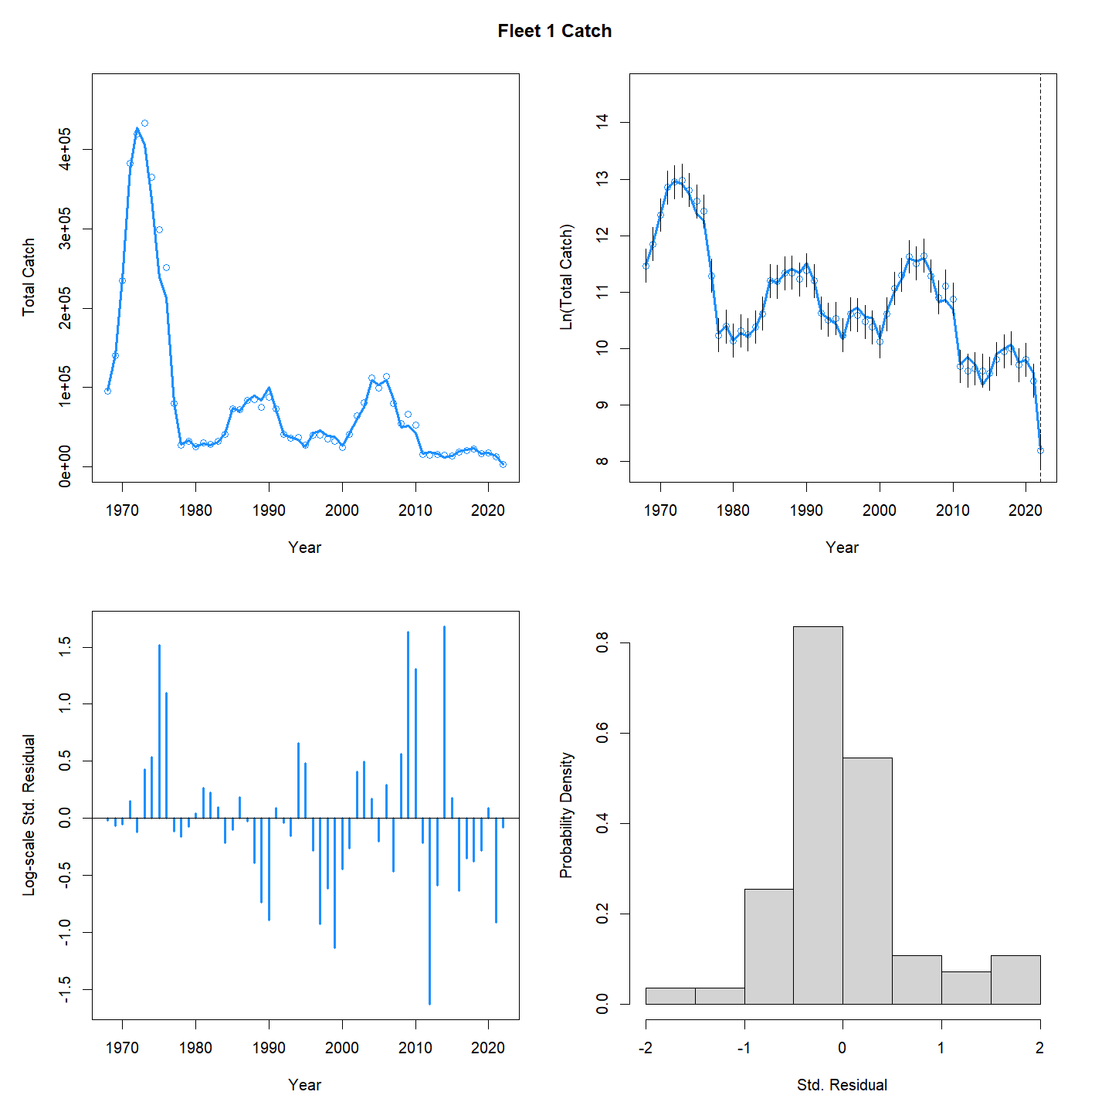
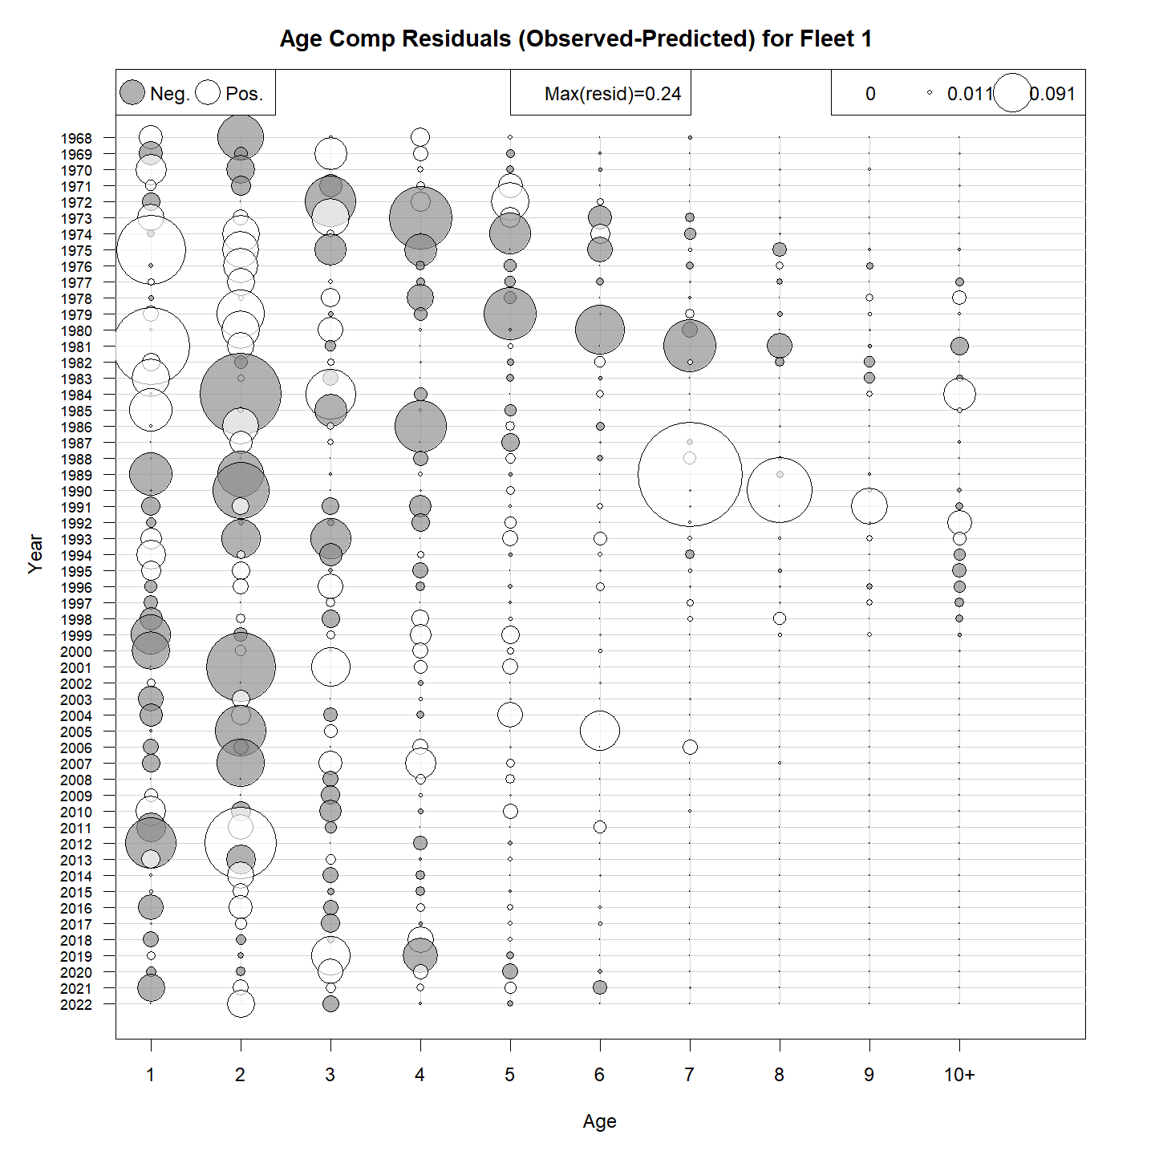
Catch

Slide 45


Albatross

Slide 46


Bigelow

Slide 47

Egg survey

Slide 48
Egg survey

Slide 49


Retro
SSB
F

